Slide 1

AMO BUDGET INFORMATION SESSION
ALLIANCE OF
MULTICULTURAL ORGANIZATIONS
The IMPACT center
For community, EquitY, and Understanding

Slide 2

About The Impact Center
The Impact Center for Community Development and Inclusion implements programs and activities that address issues of diversity, power, and privilege with a goal of improving the campus climate and enhancing community life at Bryn Mawr.
This is done with a lens that advances anti-racism, wellness, welcome, and belonging for all students, especially those who know the experience of marginalization first-hand.

Slide 3
Understanding AMO Budget$
Each AMO is eligible for up to $500 per semester from The Impact Center for Community Development & Inclusion.
- funds will be allocated according to the budget plan you submit (i.e., you may only
receive the amount of money that you have planned programming for – it will be
  important to plan your programming for the semester in advance!)
- all allocated funds must be spent according to the submitted budget (i.e., you will need
to spend funds for the purposes and in the amounts detailed in your approved budget)
- budgets do not carry over to the next academic year

Slide 4
Understanding AMO Budget$
Each semester, AMOs may submit a budget proposal to The Impact Center to support the activities and events of the AMO.
  For Fall 2023, the deadline will be 5pm on Friday, October 20th, 2023.
  (Please submit to ctaipe@brynmawr.edu.) If you cannot submit a completed budget plan by then, you must email your AMO Coordinator, AT Ortiz, and Catherine Taipe by 5:00 pm on that day or your AMO will not be funded this semester.
The semester’s budget for each AMO will be confirmed one week following the deadline. Additional information may be requested from the AMO in order to finalize the semester’s budget.
The Impact Center follows the Cash Advance, Payment and Reimbursement Policy similar to SGA (though requests will be directed to and processed by IMPACT Center, not SGA). Forms are available from AMO Coordinator or on the Impact Center website.

Slide 5
Understanding AMO Budget$
In order for an AMO to remain eligible for funding, each AMO must:
attend the budgeting meeting at the beginning of each semester;
attend at least one Impact Center community-wide event during the academic year;
co-host or collaborate on an event or activity with another AMO group during the academic year;
complete a budget proposal each semester by the stated deadline

Slide 6
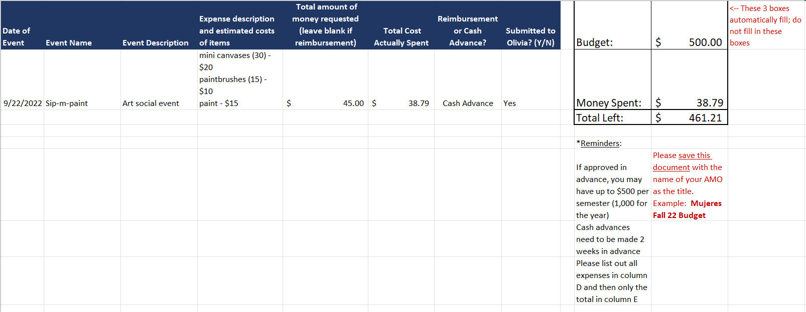
BUDGET PROPOSAL FORM

Slide 7
Purchase Request Form
Purchases are only made through the College’s procurement system and the College contract with Amazon. All other purchases must be made via Cash Advance or with a Reimbursement.
We do not accept purchase requests for food. Clubs are responsible for paying for all food purchases themselves and following all catering waiver requirements. The Impact Center will not purchase food or make advance payment to any vendor for food purchases.
All requests must be submitted by 9:00 am the Monday TWO WEEKS before your event date.
Requests are processed on Monday afternoon. Any requests received after 9am on Monday will not be processed until the following Monday.
Pick up your order from the Impact Center during regular business hours (9am-5pm M-F).

Slide 8
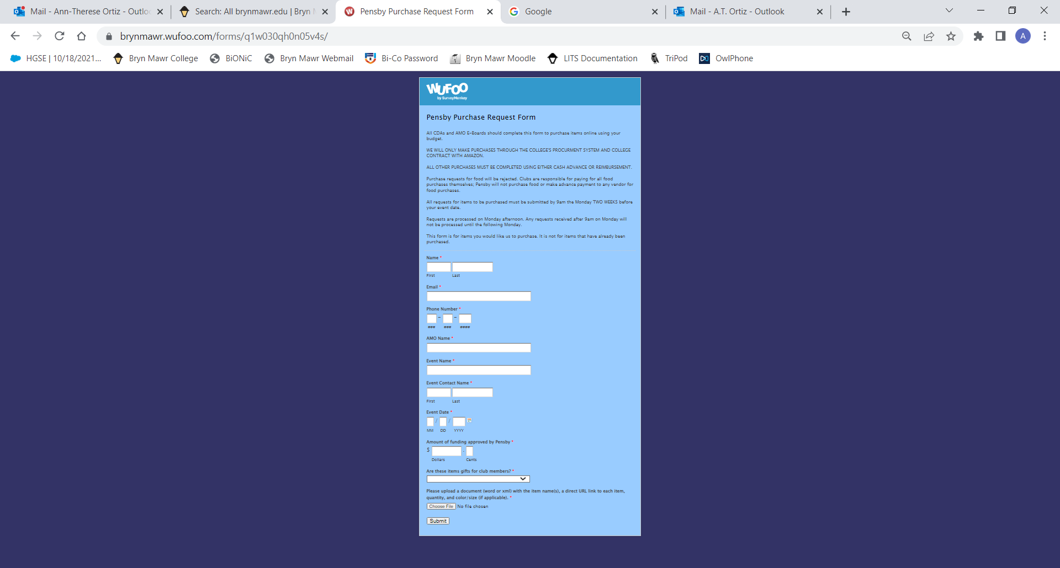
Purchase Request
Form
https://brynmawr.wufoo.com/forms/q1w030qh0n05v4s/

Slide 9
Purchase Request
Form
https://brynmawr.wufoo.com/forms/q1w030qh0n05v4s/

Slide 10
Reimbursements
Submit Expense Report form (available online or at The Impact Center). Bring completed form and original receipts to Catherine at The Impact Center.
Must include itemized receipts for reimbursement.
You will not be reimbursed unless adequate funds exist within remaining group budget – and the event/expense was approved in advance.
Reimbursements are paid on the student payroll cycle -- every two. weeks.

Slide 11
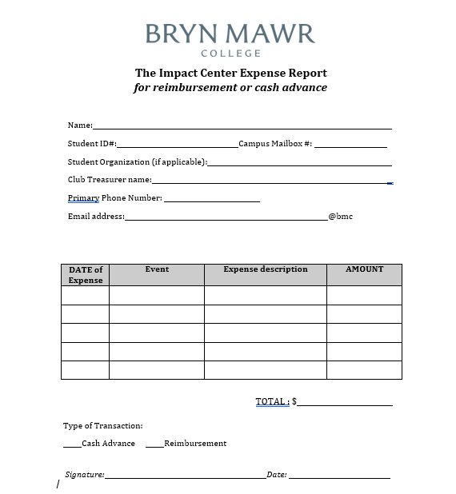
Reimbursement and Cash Advance Form
https://www.brynmawr.edu/sites/default/files/media/documents/2022-01/PensbyExpenseReport.pdf

