Slide 1
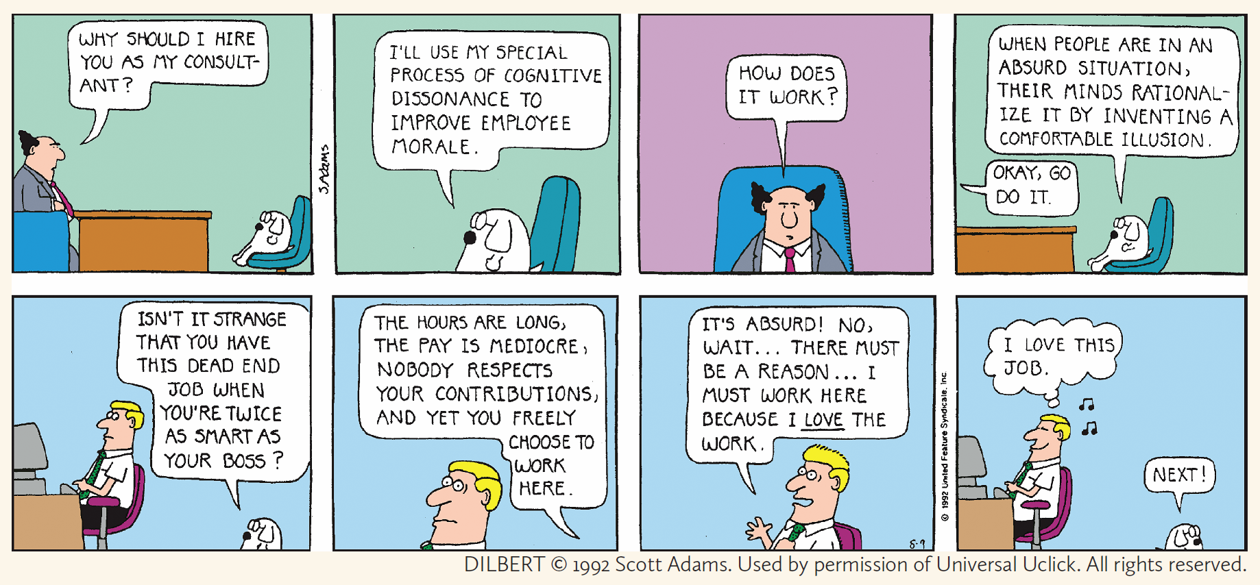
The Math of Measuring Self-Delusion
Dr. Kristopher Tapp, Saint Joseph’s University
Notes:
Dilbert cartoon about COGNITIVE DISSONANCE, a topic in psychology related to the way we RATIONALIZE OUR CHOICES. I became interested throuth a NYTIMES arcticle about how an economist at YALE who recently pointed out a logical flaw in many experiments performed over the last 5 decades to measure the effects of cognitive dissonance. It’s an interesting MATH STORY about the care that’s needed in EXPERIMENTAL DESIGN. IN THIS TALK, I’d like to describe the experiments and their flaw. I’ll END with some new results (joint with Peter Selinger) that are related to the question of whether it’s possible to fix this flaw.

Slide 2
Cognitive Dissonance: The uncomfortable cognitive state that arises when one’s actions are inconsistent with one’s underlying attitudes/beliefs (Festinger, 1957)

Slide 3
Cognitive Dissonance: The uncomfortable cognitive state that arises when one’s actions are inconsistent with one’s underlying attitudes/beliefs (Festinger, 1957)
Many experiments over 5 decades have measured our tendency to reduce dissonance by shifting our attitudes/beliefs…

Slide 4

Cognitive Dissonance: The uncomfortable cognitive state that arises when one’s actions are inconsistent with one’s underlying attitudes/beliefs (Festinger, 1957)
Many experiments over 5 decades have measured our tendency to reduce dissonance by shifting our attitudes/beliefs…
(after breaking up with him)
“I never much liked him anyways.”

Slide 5
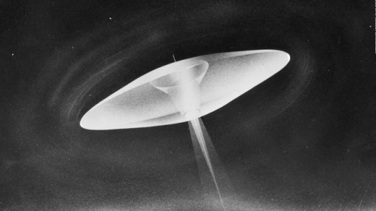



Cognitive Dissonance: The uncomfortable cognitive state that arises when one’s actions are inconsistent with one’s underlying attitudes/beliefs (Festinger, 1957)
Many experiments over 5 decades have measured our tendency to reduce dissonance by shifting our attitudes/beliefs…
Dissonance Theory began
with the end of the world.
Marion Keech, 1955
leader of “The Seekers”

Slide 6
Cognitive Dissonance: The uncomfortable cognitive state that arises when one’s actions are inconsistent with one’s underlying attitudes/beliefs (Festinger, 1957)
Many experiments over 5 decades have measured our tendency to reduce dissonance by shifting our attitudes/beliefs…
Dissonance Theory began
with the end of the world.
Final message from Clarion:
This little group, sitting all night long,
has spread so much goodness and light
that the God of the Universe has
spared the Earth from its destruction.
Marion Keech, 1955
leader of “The Seekers”

Slide 7
Cognitive Dissonance: The uncomfortable cognitive state that arises when one’s actions are inconsistent with one’s underlying attitudes/beliefs (Festinger, 1957)
Many experiments over 5 decades have measured our tendency to reduce dissonance by shifting our attitudes/beliefs…
Free Choice
Effort Justification
Induced Compliance
Dissonance Theory

Slide 8
Cognitive Dissonance: The uncomfortable cognitive state that arises when one’s actions are inconsistent with one’s underlying attitudes/beliefs (Festinger, 1957)
Many experiments over 5 decades have measured our tendency to reduce dissonance by shifting our attitudes/beliefs…
(Festinger, Carlsmith, 1958) A student performed a boring task and was paid to convince another student that the task was interesting.
FINDING: Students paid $1 were more likely than those
paid $20 to come to themselves believe that the task was interesting.
Free Choice
Effort Justification
Induced Compliance
Dissonance Theory

Slide 9
Cognitive Dissonance: The uncomfortable cognitive state that arises when one’s actions are inconsistent with one’s underlying attitudes/beliefs (Festinger, 1957)
Many experiments over 5 decades have measured our tendency to reduce dissonance by shifting our attitudes/beliefs…
Free Choice
Effort Justification
Induced Compliance
(Gerard, Mathewson, 1966) Students who went through a
severe initiation to join a dull group ended up liking the
group more than student who went through a mild initiation.
Dissonance Theory

Slide 10
Cognitive Dissonance: The uncomfortable cognitive state that arises when one’s actions are inconsistent with one’s underlying attitudes/beliefs (Festinger, 1957)
Many experiments over 5 decades have measured our tendency to reduce dissonance by shifting our attitudes/beliefs…
Free Choice
Effort Justification
Induced Compliance
Dozens of Free-Choice Paradigm experiments
have been performed, beginning with Brehm (1956).
Chen & Risen (2010) recently pointed out a logical flaw affecting the conclusions of all of them!
See if you can find the mistake…
Dissonance Theory

Slide 11
A typical Free-Choice experiment…
(Brehm 1956, and others)
QUESTION: Do we devalue things that we previously rejected?

Slide 12
A typical Free-Choice experiment…
(Brehm 1956, and others)
QUESTION: Do we devalue things that we previously rejected?
(after breaking up with your partner)
“I never much liked him/her anyways.”
(after choosing to buy the more expensive car)
“The cheaper one probably would have fallen apart.”

Slide 13
A typical Free-Choice experiment…
(Brehm 1956, and others)
QUESTION: Do we devalue things that we previously rejected?
(after breaking up with your partner)
“I never much liked him/her anyways.”
(after choosing to buy the more expensive car)
“The cheaper one probably would have fallen apart.”
Goal: Experimentally measure this “Choice-Induced Attitude Change”

Slide 14



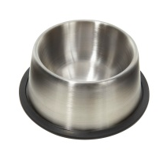
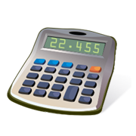
A typical Free-Choice experiment…
(Brehm 1956, and others)
STAGE 1: The subject ranks 10 objects.
1 2 3 4 5 6 7 8 9 10
(most desirable) (least desirable)

Slide 15
A typical Free-Choice experiment…
(Brehm 1956, and others)
STAGE 1: The subject ranks 10 objects.
1 2 3 4 5 6 7 8 9 10
(most desirable) (least desirable)
STAGE 2: The subject chooses between her 4th and 7th ranked objects.
(the numbers 4 and 7 are predetermined and constant over all subjects)

Slide 16
A typical Free-Choice experiment…
(Brehm 1956, and others)
STAGE 1: The subject ranks 10 objects.
1 2 3 4 5 6 7 8 9 10
(most desirable) (least desirable)
STAGE 2: The subject chooses between her 4th and 7th ranked objects.
VOCAB: Choosing the hair dryer is a consistent choice.
Choosing the toaster would have been a reversal choice.

Slide 17
A typical Free-Choice experiment…
(Brehm 1956, and others)
STAGE 1: The subject ranks 10 objects.
1 2 3 4 5 6 7 8 9 10
(most desirable) (least desirable)
STAGE 2: The subject chooses between her 4th and 7th ranked objects.
STAGE 3: The subject ranks the 10 objects again.
1 2 3 4 5 6 7 8 9 10

Slide 18
A typical Free-Choice experiment…
(Brehm 1956, and others)
1 2 3 4 5 6 7 8 9 10
(most desirable) (least desirable)
chosen object
promoted by 1
rejected object demoted by 2
Spread = 1 + 2 = 3
1 2 3 4 5 6 7 8 9 10
Spread = (amount chosen object moves left) + (amount rejected object moves right)
Spread can be positive or negative

Slide 19
A typical Free-Choice experiment…
(Brehm 1956, and others)
1 2 3 4 5 6 7 8 9 10
(most desirable) (least desirable)
chosen object
promoted by 1
rejected object demoted by 2
Spread = 1 + 2 = 3
1 2 3 4 5 6 7 8 9 10
Spread = (amount chosen object moves left) + (amount rejected object moves right)
Consistent choice: positive spread means arrows point outwards.
Reversal choice: positive spread means arrows point inwards.

Slide 20
A typical Free-Choice experiment…
(Brehm 1956, and others)
1 2 3 4 5 6 7 8 9 10
(most desirable) (least desirable)
Positive average spread was taken as evidence for dissonance theory.
the error went unnoticed…
1 2 3 4 5 6 7 8 9 10
Spread = (amount chosen object moves left) + (amount rejected object moves right)

Slide 21
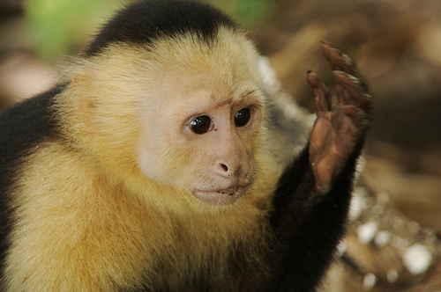
Even monkeys rationalize choices (Egan, Bloom, Santos, 2007)

Slide 22
Even monkeys rationalize choices (Egan, Bloom, Santos, 2007)
Three candy colors are identified that a capuchin monkey finds about equally desirable.

Slide 23
Even monkeys rationalize choices (Egan, Bloom, Santos, 2007)
Three candy colors are identified that a capuchin monkey finds about equally desirable.
Step one: Monkey chooses between two colors

Slide 24
Even monkeys rationalize choices (Egan, Bloom, Santos, 2007)
Three candy colors are identified that a capuchin monkey finds about equally desirable.
Step one: Monkey chooses between two colors

Slide 25
Even monkeys rationalize choices (Egan, Bloom, Santos, 2007)
Three candy colors are identified that a capuchin monkey finds about equally desirable.
Step one: Monkey chooses between two colors
Step two: Monkey chooses between the rejected color and the third color.

Slide 26
Even monkeys rationalize choices (Egan, Bloom, Santos, 2007)
Three candy colors are identified that a capuchin monkey finds about equally desirable.
Step one: Monkey chooses between two colors
Step two: Monkey chooses between the rejected color and the third color.

Slide 27
Even monkeys rationalize choices (Egan, Bloom, Santos, 2007)
Three candy colors are identified that a capuchin monkey finds about equally desirable.
Step one: Monkey chooses between two colors
Step two: Monkey chooses between the rejected color and the third color.
FINDING: about 2/3 of the time, the monkey chose the new color instead of
the previously rejected color.

Slide 28
Even monkeys rationalize choices (Egan, Bloom, Santos, 2007)
Three candy colors are identified that a capuchin monkey finds about equally desirable.
Step one: Monkey chooses between two colors
Step two: Monkey chooses between the rejected color and the third color.
FINDING: about 2/3 of the time, the monkey chose the new color instead of
the previously rejected color.
This was considered evidence for dissonance theory:
“One must either accept that these psychological processes are
mechanistically simpler than previously thought or ascribe richer
motivational complexity to monkeys and children…”

Slide 29
Even monkeys rationalize choices (Egan, Bloom, Santos, 2007)
Three candy colors are identified that a capuchin monkey finds about equally desirable.
Step one: Monkey chooses between two colors
Step two: Monkey chooses between the rejected color and the third color.
FINDING: about 2/3 of the time, the monkey chose the new color instead of
the previously rejected color.
Chen & Risen (2010): 2/3 is exactly what one should expect for mathematical
reasons, without assuming monkeys ever change their minds.

Slide 30
Chen & Risen (2010) explanation:
Chen & Risen (2010): Expect 2/3 even if
monkeys never change their minds:

Slide 31
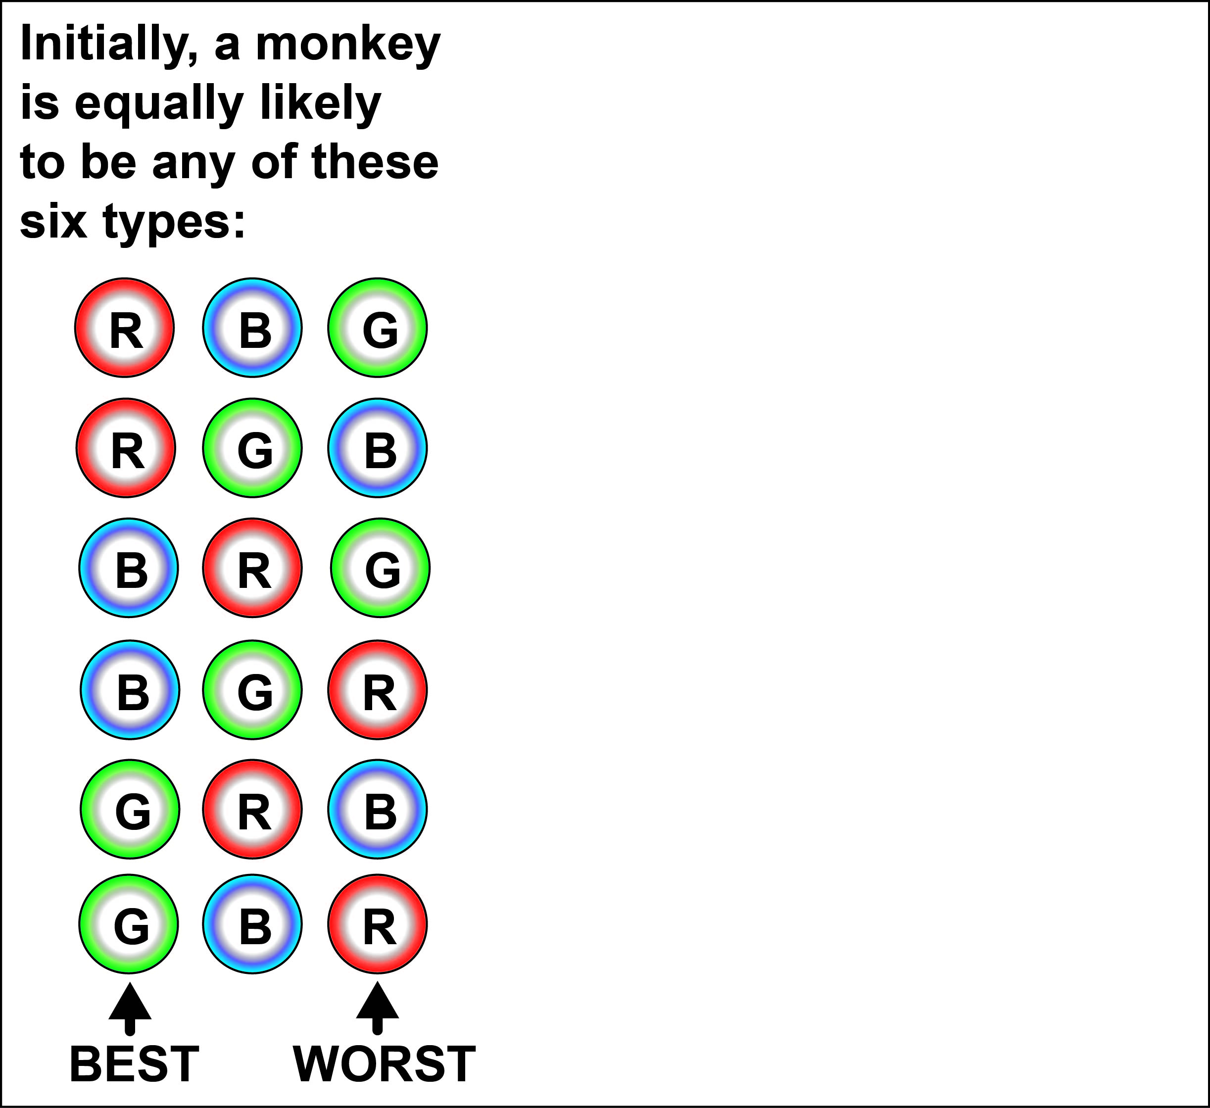
Chen & Risen (2010) explanation:
Chen & Risen (2010): Expect 2/3 even if
monkeys never change their minds:

Slide 32
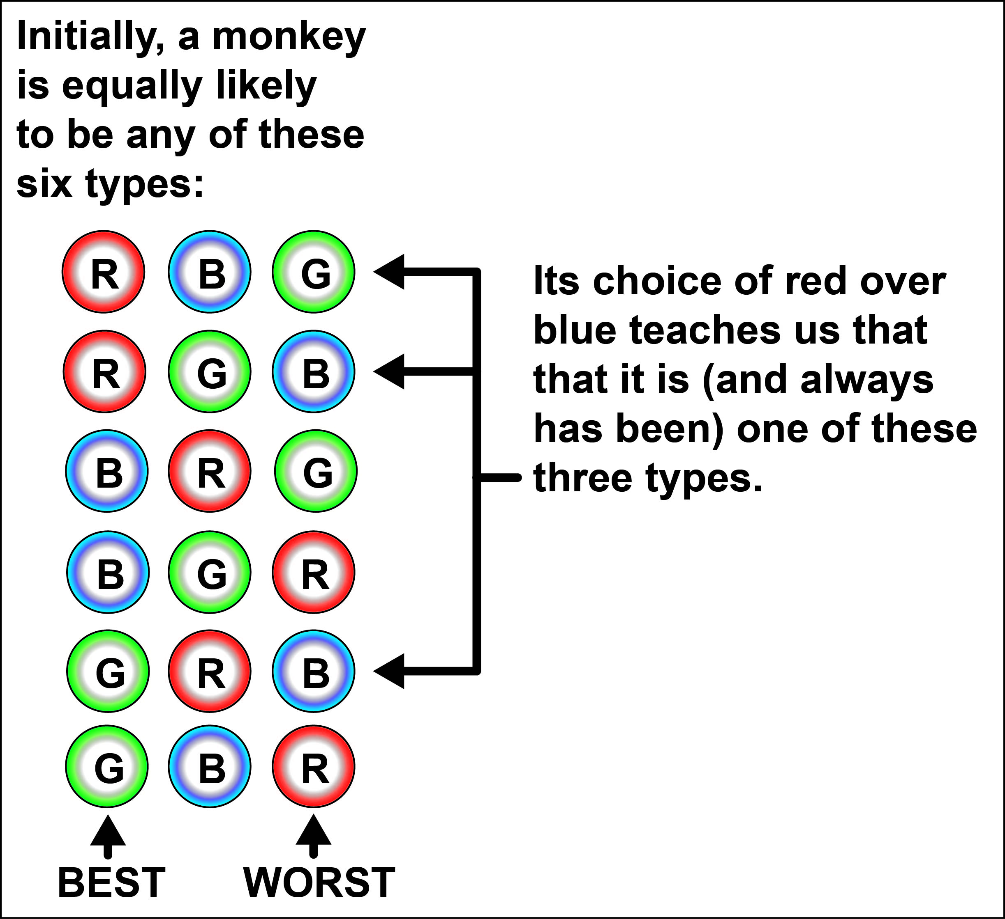
Chen & Risen (2010) explanation:
Chen & Risen (2010): Expect 2/3 even if
monkeys never change their minds:

Slide 33
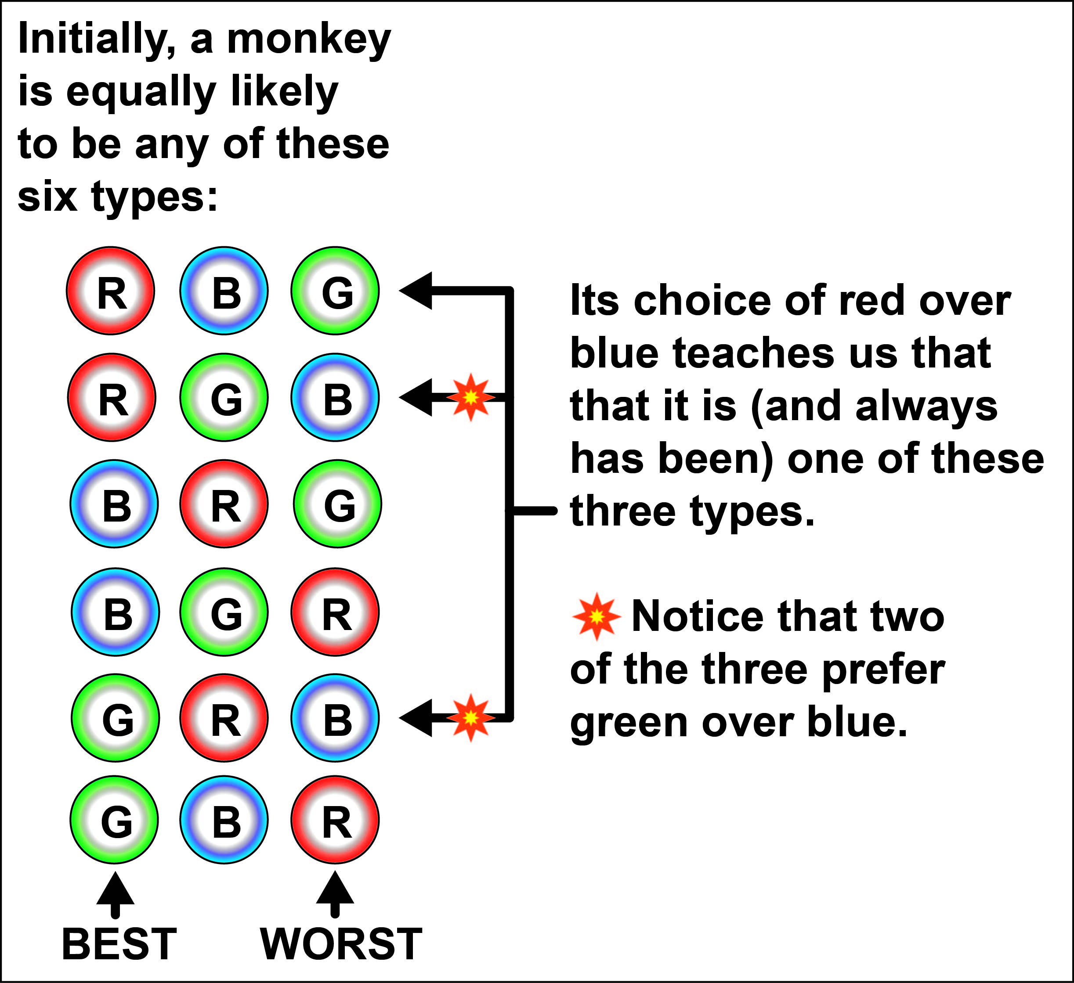
Chen & Risen (2010) explanation:
Chen & Risen (2010): Expect 2/3 even if
monkeys never change their minds:

Slide 34
Chen & Risen (2010): Expect 2/3 even if
monkeys never change their minds:
The monkey’s choice in step 2 is exactly what we should expect from the type of monkey it revealed itself to be in step 1.

Slide 35
What’s wrong with the human experiments?

Slide 36
Chen & Risen (2010): Expect positive spread even if subjects never change their minds:
What’s wrong with the human experiments?

Slide 37
Chen & Risen (2010): Expect positive spread even if subjects never change their minds.
NULL HYPOTHESIS: Subjects never change their minds.
Each subject has a never-changing “true ranking” of the 10 objects.
Random noise can cause her step-1 and step-3 rankings to differ from her true ranking,
and can causes her step-2 choice to be inconsistent with her true ranking.

Slide 38
Chen & Risen (2010): Expect positive spread even if subjects never change their minds.
NULL HYPOTHESIS: Subjects never change their minds.
Each subject has a never-changing “true ranking” of the 10 objects.
Random noise can cause her step-1 and step-3 rankings to differ from her true ranking,
and can causes her step-2 choice to be inconsistent with her true ranking.

Slide 39
Chen & Risen (2010): Expect positive spread even if subjects never change their minds.
NULL HYPOTHESIS: Subjects never change their minds.
Each subject has a never-changing “true ranking” of the 10 objects.
Random noise can cause her step-1 and step-3 rankings to differ from her true ranking,
and can causes her step-2 choice to be inconsistent with her true ranking.
Under natural hypotheses on the distributions by which this random noise is modeled,
THEOREM (Chen-Risen): Positive spread is predicted under the null hypothesis model.

Slide 40
Chen & Risen (2010): Expect positive spread even if subjects never change their minds.
1 2 3 4 5 6 7 8 9 10
(most desirable) (least desirable)
1 2 3 4 5 6 7 8 9 10
Why expect positive spread from someone like this who exhibits a reversal?

Slide 41
Chen & Risen (2010): Expect positive spread even if subjects never change their minds.
1 2 3 4 5 6 7 8 9 10
(most desirable) (least desirable)
After step 1, what do we know about her feelings for hair dryers and toasters?
Why expect positive spread from someone like this who exhibits a reversal?

Slide 42
Chen & Risen (2010): Expect positive spread even if subjects never change their minds.
1 2 3 4 5 6 7 8 9 10
(most desirable) (least desirable)
After step 2, what do we know about her feelings for hair dryers and toasters?
Why expect positive spread from someone like this who exhibits a reversal?

Slide 43
Chen & Risen (2010): Expect positive spread even if subjects never change their minds.
1 2 3 4 5 6 7 8 9 10
(most desirable) (least desirable)
After step 2, what do we know about her feelings for hair dryers and toasters?
Probably, she truly likes toasters more (and hair dryers less)
than her first ranking indicated.
Why expect positive spread from someone like this who exhibits a reversal?

Slide 44
Chen & Risen (2010): Expect positive spread even if subjects never change their minds.
1 2 3 4 5 6 7 8 9 10
(most desirable) (least desirable)
After step 2, what do we know about her feelings for hair dryers and toasters?
Probably, she truly likes toasters more (and hair dryers less)
than her first ranking indicated.
Thus, positive spread is what we should expect from the type of person she revealed
herself to by in step 2.
Why expect positive spread from someone like this who exhibits a reversal?

Slide 45
STEP 1
1 2 3 4 5 6 7 8 9 10
STEP 2
1 2 3 4 5 6 7 8 9 10
STEP 3
Chen & Risen solution:
Use a control group whose members perform the same three steps
in the order RANK → RANK → CHOOSE .

Slide 46
STEP 1
1 2 3 4 5 6 7 8 9 10
STEP 2
1 2 3 4 5 6 7 8 9 10
STEP 3
Chen & Risen solution:
Use a control group whose members perform the same three steps
in the order RANK → RANK → CHOOSE .
If nobody changed their minds, then order would not matter, so average spread
would be the same for experimental group and control group.
If dissonance reduction causes step 2 choice to effect step 3 ranking, this will only show up in experimental group.

Slide 47
STEP 1
1 2 3 4 5 6 7 8 9 10
STEP 2
1 2 3 4 5 6 7 8 9 10
STEP 3
Chen & Risen solution:
Use a control group whose members perform the same three steps
in the order RANK → RANK → CHOOSE .
Their experimental data provided only nominal support for dissonance theory.

Slide 48
1 2 3 i=4 5 6 j=7 8 9 n=10
(most desirable) (least desirable)
Δ = 7 – 4 = 3
What if other choices of { n, i , j } are used?

Slide 49
1 2 3 i=4 5 6 j=7 8 9 n=10
(most desirable) (least desirable)
Δ = 7 – 4 = 3
What if other choices of { n, i , j } are used?
THEOREM (Chen-Risen): Positive spread is predicted under the null hypothesis model
for any choices of { n, i, j }.

Slide 50
1 2 3 i=4 5 6 j=7 8 9 n=10
(most desirable) (least desirable)
Δ = 7 – 4 = 3
What if other choices of { n, i , j } are used?
THEOREM (Chen-Risen): Positive spread is predicted under the null hypothesis model
for any choices of { n, i, j }.
But they noted that their proof is invalid when Δ is large, due to regression to the mean.

Slide 51
i=1 2 3 4 5 6 7 8 9 j=n=10
Δ = 9
What spread do you expect here?
THEOREM (Chen-Risen): Positive spread is predicted under the null hypothesis model
for any choices of { n, i, j }.
But they noted that their proof is invalid when Δ is large, due to regression to the mean.

Slide 52
i=1 2 3 4 5 6 7 8 9 j=n=10
Δ = 9
What spread do you expect here?
THEOREM (Chen-Risen): Positive spread is predicted under the null hypothesis model
for any choices of { n, i, j }.
But they noted that their proof is invalid when Δ is large, due to regression to the mean.
GUESS:
Expect positive spread when Δ is small (by Chen-Risen probability arguments).
Expect negative spread when Δ is large (by regression to mean).

Slide 53
Joint work with Peter Selinger:
(1) A free-choice experiment with no control group.
(2) Computer simulated examples of spread for different (i,j) choices.
(3) Which free-choice experiment is best?
(4) Further problems with ALL free-choice experiments.

Slide 54
Joint work with Peter Selinger:
(1) A free-choice experiment with no control group.
(2) Computer simulated examples of spread for different (i,j) choices.
(3) Which free-choice experiment is best?
(4) Further problems with ALL free-choice experiments.

Slide 55
Joint work with Peter Selinger:
(1) A free-choice experiment with no control group.
(2) Computer simulated examples of spread for different (i,j) choices.
(3) Which free-choice experiment is best?
(4) Further problems with ALL free-choice experiments.

Slide 56
Joint work with Peter Selinger:
(1) A free-choice experiment with no control group.
(2) Computer simulated examples of spread for different (i,j) choices.
(3) Which free-choice experiment is best?
(4) Further problems with ALL free-choice experiments.

Slide 57
Joint work with Peter Selinger: A free-choice experiment with no control group.

Slide 58
Joint work with Peter Selinger: A free-choice experiment with no control group.
NULL HYPOTHESIS: The subject never changes her mind.
One ranking function, r: {permutations of the n objects} → [0,1] is used in steps 1 & 3.
(we’re not assuming she has a well-defined “true ranking”)

Slide 59
Joint work with Peter Selinger: A free-choice experiment with no control group.
NULL HYPOTHESIS: The subject never changes her mind.
One ranking function, r: {permutations of the n objects} → [0,1] is used in steps 1 & 3.
THEOREM: Under the null hypothesis, the expected average spread equals zero if the free-choice experiment is modified in any of these ways:
All subjects make their stage-two choices between the same pre-selected pair of comparison objects (like hairdryer and toaster).
Each subject makes her stage-two choice between the objects she just ranked in a pair of comparison positions (like 4 and 7) that is uniformly randomly chosen separately for each subject.
Each possible pair of comparison positions is used, one for each subject.

Slide 60
Joint work with Peter Selinger: A free-choice experiment with no control group.
NULL HYPOTHESIS: The subject never changes her mind.
One ranking function, r: {permutations of the n objects} → [0,1] is used in steps 1 & 3.
THEOREM: Under the null hypothesis, the expected average spread equals zero if the free-choice experiment is modified in any of these ways:
All subjects make their stage-two choices between the same pre-selected pair of comparison objects (like hairdryer and toaster).
Each subject makes her stage-two choice between the objects she just ranked in a pair of comparison positions (like 4 and 7) that is uniformly randomly chosen separately for each subject.
Each possible pair of comparison positions is used, one for each subject.

Slide 61
Joint work with Peter Selinger: A free-choice experiment with no control group.
NULL HYPOTHESIS: The subject never changes her mind.
One ranking function, r: {permutations of the n objects} → [0,1] is used in steps 1 & 3.
THEOREM: Under the null hypothesis, the expected average spread equals zero if the free-choice experiment is modified in any of these ways:
All subjects make their stage-two choices between the same pre-selected pair of comparison objects (like hairdryer and toaster).
Each subject makes her stage-two choice between the objects she just ranked in a pair of comparison positions (like 4 and 7) that is uniformly randomly chosen separately for each subject.
Each possible pair of comparison positions is used, one for each subject.

Slide 62
Joint work with Peter Selinger: A free-choice experiment with no control group.
NULL HYPOTHESIS: The subject never changes her mind.
One ranking function, r: {permutations of the n objects} → [0,1] is used in steps 1 & 3.
THEOREM: Under the null hypothesis, the expected average spread equals zero if the free-choice experiment is modified in any of these ways:
All subjects make their stage-two choices between the same pre-selected pair of comparison objects (like hairdryer and toaster).
Each subject makes her stage-two choice between the objects she just ranked in a pair of comparison positions (like 4 and 7) that is uniformly randomly chosen separately for each subject.
Each possible pair of comparison positions is used, one for each subject.
For example, with 10 objects, there are 45 pairs of distinct numbers between 1 and 10, so this experiment requires exactly 45 subjects.

Slide 63
Joint work with Peter Selinger: A free-choice experiment with no control group.
NULL HYPOTHESIS: The subject never changes her mind.
One ranking function, r: {permutations of the n objects} → [0,1] is used in steps 1 & 3.
THEOREM: Under the null hypothesis, the expected average spread equals zero if the free-choice experiment is modified in any of these ways:
All subjects make their stage-two choices between the same pre-selected pair of comparison objects (like hairdryer and toaster).
Each subject makes her stage-two choice between the objects she just ranked in a pair of comparison positions (like 4 and 7) that is uniformly randomly chosen separately for each subject.
Each possible pair of comparison positions is used, one for each subject.
1,2,3 are methods for conducting a free-choice experiment without a control group!

Slide 64
Joint work with Peter Selinger: A free-choice experiment with no control group.
NULL HYPOTHESIS: The subject never changes her mind.
One ranking function, r: {permutations of the n objects} → [0,1] is used in steps 1 & 3.
THEOREM: Under the null hypothesis, the expected average spread equals zero if the free-choice experiment is modified in any of these ways:
All subjects make their stage-two choices between the same pre-selected pair of comparison objects (like hairdryer and toaster).
Each subject makes her stage-two choice between the objects she just ranked in a pair of comparison positions (like 4 and 7) that is uniformly randomly chosen separately for each subject.
Each possible pair of comparison positions is used, one for each subject.
Proof of (1): Her step-1 and step-3 rankings are equally likely to occur
in the opposite order, which changes the sign of the spread.
Thus, (expected spread) = − (expected spread).

Slide 65
Joint work with Peter Selinger: A free-choice experiment with no control group.
NULL HYPOTHESIS: The subject never changes her mind.
One ranking function, r: {permutations of the n objects} → [0,1] is used in steps 1 & 3.
THEOREM: Under the null hypothesis, the expected average spread equals zero if the free-choice experiment is modified in any of these ways:
All subjects make their stage-two choices between the same pre-selected pair of comparison objects (like hairdryer and toaster).
Each subject makes her stage-two choice between the objects she just ranked in a pair of comparison positions (like 4 and 7) that is uniformly randomly chosen separately for each subject.
Each possible pair of comparison positions is used, one for each subject.
Proof of (2): The pair of comparison objects will depend here on:
The pair of ranking positions, chosen uniformly at random.
The subject's stage-one ranking, sampled from her ranking distribution.
Since these two processes are independent, their order is irrelevant.
If we imagine that the subject's ranking is provided first, for any fixed ranking
she provides, randomly choosing a pair of positions from this fixed ranking
is equivalent to randomly choosing a pair of objects.

Slide 66
Joint work with Peter Selinger: A free-choice experiment with no control group.
NULL HYPOTHESIS: The subject never changes her mind.
One ranking function, r: {permutations of the n objects} → [0,1] is used in steps 1 & 3.
THEOREM: Under the null hypothesis, the expected average spread equals zero if the free-choice experiment is modified in any of these ways:
All subjects make their stage-two choices between the same pre-selected pair of comparison objects (like hairdryer and toaster).
Each subject makes her stage-two choice between the objects she just ranked in a pair of comparison positions (like 4 and 7) that is uniformly randomly chosen separately for each subject.
Each possible pair of comparison positions is used, one for each subject.
Proof of (3): Follows from (2).

Slide 67
Joint work with Peter Selinger: A computer simulated example.

Slide 68
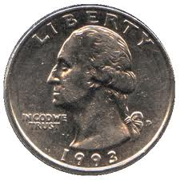
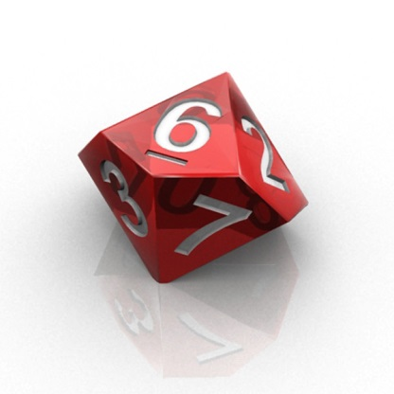
Joint work with Peter Selinger: A computer simulated example.
Ranking algorithm: (1) Begin with true ranking.
(2) Flip a weighted coin. If heads, then swap the objects in a
randomly chosen pair of adjacent positions. Repeat.
(3) Stop making changes when the coin first lands tails.
Choosing algorithm: Use the ranking algorithm to rank all n objects,
and choose the better-ranked one of the pair.
1 2 3 4 5 6 7 8 9 10
(most desirable) (least desirable)

Slide 69
Joint work with Peter Selinger: A computer simulated example.
Ranking algorithm: (1) Begin with true ranking.
(2) Flip a weighted coin. If heads, then swap the objects in a
randomly chosen pair of adjacent positions. Repeat.
(3) Stop making changes when the coin first lands tails.
Choosing algorithm: Use the ranking algorithm to rank all n objects,
and choose the better-ranked one of the pair.

Slide 70
Joint work with Peter Selinger: A computer simulated example.
Ranking algorithm: (1) Begin with true ranking.
(2) Flip a weighted coin. If heads, then swap the objects in a
randomly chosen pair of adjacent positions. Repeat.
(3) Stop making changes when the coin first lands tails.
Choosing algorithm: Use the ranking algorithm to rank all n objects,
and choose the better-ranked one of the pair.
Expected spread for
a single subject
n=12, P(Heads)=0.8
Expect about 5 random adjacent swaps.

Slide 71
Joint work with Peter Selinger: A computer simulated example.
Ranking algorithm: (1) Begin with true ranking.
(2) Flip a weighted coin. If heads, then swap the objects in a
randomly chosen pair of adjacent positions. Repeat.
(3) Stop making changes when the coin first lands tails.
Choosing algorithm: Use the ranking algorithm to rank all n objects,
and choose the better-ranked one of the pair.
Expected spread for
a single subject
n=12, P(Heads)=0.8
(exact values have been
rounded to 3 decimals.)
 | i = 1 | 2 | 3 | 4 | 5 | 6 | 7 | 8 | 9 | 10 | 11 | 12
j = 1 | −
2 | .319 | −
3 | −.010 | .557 | −
4 | −.251 | .247 | .661 | −
5 | −.389 | .051 | .346 | .694 | −
6 | −.458 | −.057 | .154 | .376 | .702 | −
7 | −.492 | −.111 | .050 | .184 | .384 | .704 | −
8 | −.508 | −.138 | −.004 | .079 | .190 | .384 | .702 | −
9 | −.523 | −.157 | −.036 | .019 | .079 | .184 | .376 | .694 | −
10 | −.557 | −.193 | −.078 | −.036 | −.004 | .050 | .154 | .346 | .661 | −
11 | −.669 | −.306 | −.193 | −.157 | −.138 | −.111 | −.057 | .051 | .247 | .557 | −
12 | −1.031 | −.669 | −.557 | −.523 | −.508 | −.492 | −.458 | −.389 | −.251 | −.010 | .319 | −

Slide 72
Joint work with Peter Selinger: A computer simulated example.
Ranking algorithm: (1) Begin with true ranking.
(2) Flip a weighted coin. If heads, then swap the objects in a
randomly chosen pair of adjacent positions. Repeat.
(3) Stop making changes when the coin first lands tails.
Choosing algorithm: Use the ranking algorithm to rank all n objects,
and choose the better-ranked one of the pair.
Expected spread for
a single subject
n=12, P(Heads)=0.8
(exact values have been
rounded to 3 decimals.)
 | i = 1 | 2 | 3 | 4 | 5 | 6 | 7 | 8 | 9 | 10 | 11 | 12
j = 1 | −
2 | .319 | −
3 | −.010 | .557 | −
4 | −.251 | .247 | .661 | −
5 | −.389 | .051 | .346 | .694 | −
6 | −.458 | −.057 | .154 | .376 | .702 | −
7 | −.492 | −.111 | .050 | .184 | .384 | .704 | −
8 | −.508 | −.138 | −.004 | .079 | .190 | .384 | .702 | −
9 | −.523 | −.157 | −.036 | .019 | .079 | .184 | .376 | .694 | −
10 | −.557 | −.193 | −.078 | −.036 | −.004 | .050 | .154 | .346 | .661 | −
11 | −.669 | −.306 | −.193 | −.157 | −.138 | −.111 | −.057 | .051 | .247 | .557 | −
12 | −1.031 | −.669 | −.557 | −.523 | −.508 | −.492 | −.458 | −.389 | −.251 | −.010 | .319 | −
SYMMETRY:
The 66 cells
sum to zero!

Slide 73
Joint work with Peter Selinger: Which free-choice experiment is best?

Slide 74
Joint work with Peter Selinger: Which free-choice experiment is best?
E0 (Chen-Risen) control group uses rank-rank-choose order.
E1 “Hairdryer” and “Toaster” used for all subjects.
E2 Random pair of comparison positions chosen separately for each subject.
E3 One subject per possible pair of comparison positions.
No Control Group

Slide 75
Joint work with Peter Selinger: Which free-choice experiment is best?
E0 (Chen-Risen) control group uses rank-rank-choose order.
E1 “Hairdryer” and “Toaster” used for all subjects.
E2 Random pair of comparison positions chosen separately for each subject.
E3 One subject per possible pair of comparison positions.
Wastes half of the subjects on a control group.
Added variability in spread difference between control and experimental group.

Slide 76
Joint work with Peter Selinger: Which free-choice experiment is best?
E0 (Chen-Risen) control group uses rank-rank-choose order.
E1 “Hairdryer” and “Toaster” used for all subjects.
E2 Random pair of comparison positions chosen separately for each subject.
E3 One subject per possible pair of comparison positions.
Wastes subjects on (i,j) choices far enough apart that dissonance researchers would
not hypothesize any spread due to dissonance.
Dissonance and attitude change are only theorized to emerge when the choice is hard,
so that the subject feels a need to rationalize choosing one over the other.

Slide 77
Joint work with Peter Selinger: Which free-choice experiment is best?
E0 (Chen-Risen) control group uses rank-rank-choose order.
E1 “Hairdryer” and “Toaster” used for all subjects.
E2 Random pair of comparison positions chosen separately for each subject.
E3 One subject per possible pair of comparison positions.
Wastes subjects on (i,j) choices far enough apart that dissonance researchers would
not hypothesize any spread due to dissonance.
Dissonance and attitude change are only theorized to emerge when the choice is hard,
so that the subject feels a need to rationalize choosing one over the other.
Computer simulations (using coin-flipping algorithm)
suggest that E0’s waste roughly balances E2-E3’s waste.
Typically, E0 was a bit better, but it depends how the
dependence on ∆ of the strength of the dissonance effect is modeled.

Slide 78
Joint work with Peter Selinger: Which free-choice experiment is best?
E0 (Chen-Risen) control group uses rank-rank-choose order.
E1 “Hairdryer” and “Toaster” used for all subjects.
E2 Random pair of comparison positions chosen separately for each subject.
E3 One subject per possible pair of comparison positions.
Not all subjects perform the same task, so how can you make claims about the
statistical significance of the outcome?

Slide 79
Joint work with Peter Selinger: Which free-choice experiment is best?
E0 (Chen-Risen) control group uses rank-rank-choose order.
E1 “Hairdryer” and “Toaster” used for all subjects.
E2 Random pair of comparison positions chosen separately for each subject.
E3 One subject per possible pair of comparison positions.
If most subjects rank “hairdryer” and “toaster” close together near the middle,
then not many subjects are wasted.
Difficult to simulate E1. Need to know how true-rankings vary from subject to
subject, which depends on the objects used and how real humans feel about them.

Slide 80
Joint work with Peter Selinger: Further problems with ALL free-choice experiments.
(including the Chen-Risen experiment and all of our control-group-free methods)

Slide 81
Joint work with Peter Selinger: Further problems with ALL free-choice experiments.
A positive outcome could be blamed on psychological phenomena other than dissonance!

Slide 82
Joint work with Peter Selinger: Further problems with ALL free-choice experiments.
A positive outcome could be blamed on psychological phenomena other than dissonance!
PHENOMENON 1: MEMORY. The subject remembers her choice and is inclined to construct a final ranking that is consistent with it.

Slide 83
Joint work with Peter Selinger: Further problems with ALL free-choice experiments.
A positive outcome could be blamed on psychological phenomena other than dissonance!
PHENOMENON 1: MEMORY. The subject remembers her choice and is inclined to construct a final ranking that is consistent with it.
Memory alone can account for positive outcomes in E0, E1, E2, E3.

Slide 84
Joint work with Peter Selinger: Further problems with ALL free-choice experiments.
A positive outcome could be blamed on psychological phenomena other than dissonance!
PHENOMENON 1: MEMORY. The subject remembers her choice and is inclined to construct a final ranking that is consistent with it.
PHENOMENON 2: “Think about it more carefully” The act of choosing between two objects does NOT change the subject’s true ranking, but does force her to think more carefully about the true positions of these objects in her true ranking.

Slide 85
Joint work with Peter Selinger: Further problems with ALL free-choice experiments.
A positive outcome could be blamed on psychological phenomena other than dissonance!
PHENOMENON 1: MEMORY. The subject remembers her choice and is inclined to construct a final ranking that is consistent with it.
PHENOMENON 2: “Think about it more carefully” The act of choosing between two objects does NOT change the subject’s true ranking, but does force her to think more carefully about the true positions of these objects in her true ranking.
This is easily modeled using two volumes of random noise:
p₁ (large) for the first ranking.
p₂ (small) for the choice and the second ranking.

Slide 86
Joint work with Peter Selinger: Further problems with ALL free-choice experiments.
A positive outcome could be blamed on psychological phenomena other than dissonance!
PHENOMENON 1: MEMORY. The subject remembers her choice and is inclined to construct a final ranking that is consistent with it.
PHENOMENON 2: “Think about it more carefully” The act of choosing between two objects does NOT change the subject’s true ranking, but does force her to think more carefully about the true positions of these objects in her true ranking.
This is easily modeled using two volumes of random noise:
p₁ (large) for the first ranking.
p₂ (small) for the choice and the second ranking.
Outcome: E0, E2, E3 can all be fooled into reporting significantly positive average
spread, even though the subjects never change their true rankings.

Slide 87
Joint work with Peter Selinger: Further problems with ALL free-choice experiments.
A positive outcome could be blamed on psychological phenomena other than dissonance!
PHENOMENON 1: MEMORY. The subject remembers her choice and is inclined to construct a final ranking that is consistent with it.
PHENOMENON 2: “Think about it more carefully” The act of choosing between two objects does NOT change the subject’s true ranking, but does force her to think more carefully about the true positions of these objects in her true ranking.
This is easily modeled using two volumes of random noise:
p₁ (large) for the first ranking.
p₂ (small) for the choice and the second ranking.
Outcome: E0, E2, E3 can all be fooled into reporting significantly positive average
spread, even though the subjects never change their true rankings.
Conclusion: It is still not clear whether ANY type of free-choice experiment can
correctly measure choice-induced attitude change caused by dissonance.

