Slide 1
Euler Characteristic for Data Analysis
Matthew L. Wright
Institute for Mathematics and its Applications
University of Minnesota

Slide 2
For a polyhedron,
?
(# vertices)
– (# edges)
+ (# faces)
=
4
– 6
+ 4
= 2
vertices
edges
faces

Slide 3
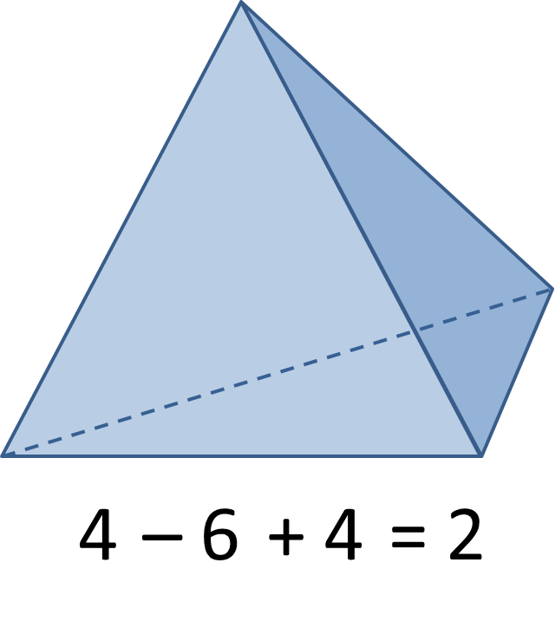
For a polyhedron,
?
(# vertices)
– (# edges)
+ (# faces)
=

Slide 4
For a polyhedron,
?
(# vertices)
– (# edges)
+ (# faces)
=
8
– 12
+ 6
= 2
vertices
edges
faces

Slide 5
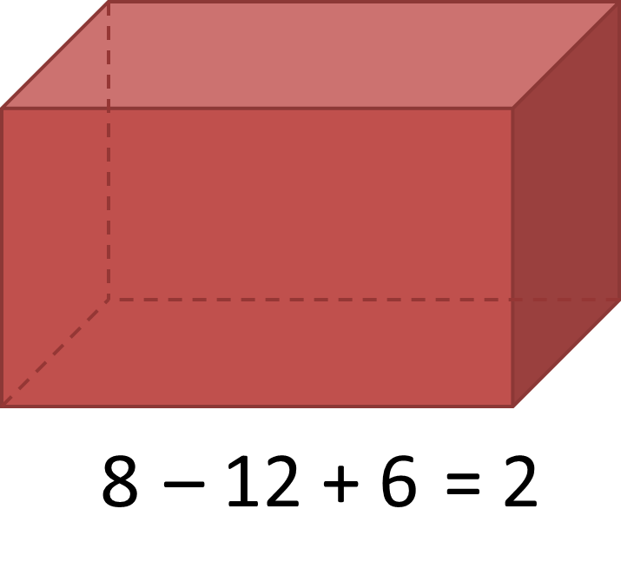
For a polyhedron,
?
(# vertices)
– (# edges)
+ (# faces)
=

Slide 6
For a polyhedron,
?
(# vertices)
– (# edges)
+ (# faces)
=
The Euler characteristic of a polyhedron is 2.
$$χ$$
$($polyhedron$)$ = 2

Slide 7
Euler Characteristic, more generally:
Finite set
Finite graph, no loops
Finite graph, with loops
Compact planar region
$$χ$$
= 8 – 12 + 3 = -1
= 8 – 5 = 3
= 8 – 6 = 2
= 8
(number of connected components) – (number of holes)

Slide 8
Definition: Let $X$ be a finite simplicial complex containing $A_{i}$ open simplices of dimension $i$.
$A_{0}=$ number of vertices of $A$
$A_{1}=$ number of edges of $A$
$A_{2}=$ number of faces of $A$
etc.
Then the Euler Characteristic of $A$ is:
$$χ\left(A\right)=\sum_{i=0}^{∞}{{\left(−1\right)}^{i}A_{i}}$$

Slide 9
Nota Bene
Euler Characteristic is independent of decomposition:
$$χ$$
$$χ$$
= 1
= 1
…but is sensitive to open/closed sets:
$$χ$$
$$χ$$
= 0
= -1

Slide 10
Key Property
For sets $A$ and $B$,
$$χ\left(A∪B\right)=χ\left(A\right)+χ\left(B\right)−χ\left(A∩B\right).$$
This property is called additivity, or the inclusion-exclusion principle.
$$A$$
$$A∪B$$
$$B$$
$$A∩B$$

Slide 11
1
Euler Integral

Slide 12
Integral with respect to Euler Characteristic
Let $A$ be a set in $ℝ^{n}$, and let $1_{A}$ be the function with value 1 on set $A$ and 0 otherwise.
The Euler Integral of $1_{A}$ is:
$$\int_{ℝ^{n}}^{ }{1_{A} dχ}=χ(A)$$
For a function $f:ℝ^{n}→ℤ$, with finite range,
$$\int_{ℝ^{n}}^{ }{f dχ}=\sum_{c}^{ }{c χ\{f=c\}}.$$
set on which $f=c$

Slide 13
Example: consider $f : ℝ→ℤ$
$$\int_{ℝ^{n}}^{ }{f dχ=}\sum_{c}^{ }{c χ\{f=c\}}$$
3
$$f(x)$$
$$=1⋅0$$
$$←c=1$$
2
$+ 2⋅(−1)$
$$←c=2$$
$$+ 3⋅2$$
$$←c=3$$
1
$$=4$$
$$x$$
Euler integral of $f$

Slide 14
Theorem: For $f: ℝ→ℤ$,
$$\int{f dχ}=\sum_{s=−∞}^{∞}{sχ\left\{f=s\right\}}=\sum_{s=1}^{∞}{\left(χ\left\{f≥s\right\}−χ\{f≤−s\}\right)}$$
Preferred in practice!
Proof:
$$f=\sum_{s=−∞}^{∞}{s1_{\{f=s\}}}$$
$$=\sum_{s=1}^{∞}{s\left(1_{\{f≥s\}}−1_{\{f>s\}}\right)}+\sum_{s=−1}^{−∞}{s\left(1_{\{f≤s\}}−1_{\{f<s\}}\right)}$$
$$=\sum_{s=1}^{∞}{s\left(1_{\{f≥s\}}−1_{\{f≥s+1\}}\right)}+\sum_{s=−1}^{−∞}{s\left(1_{\{f≤s\}}−1_{\{f≤s−1\}}\right)}$$
telescoping sums
$$f=\sum_{s=1}^{∞}{\left(1_{\{f≥s\}}−1_{\{f≤−s\}}\right)}$$
Now integrate.

Slide 15
Suppose we have a collection of sets in a domain and a function $f$ that counts the number of sets at each point.
$$f$$
1
3
4
3
2
1
0
2
1
2
0
2
1
0
2
1
1
3
4
1
3
2
2
3
2
1
2
1
1
0

Slide 16
Suppose we have a collection of sets in a domain and a function $f$ that counts the number of sets at each point.
$$f$$
1
3
4
3
2
1
0
If each set has the same (nonzero) Euler characteristic, then the Euler integral of $f$ gives the number of sets in the collection.
2
1
2
0
2
1
0
2
1
1
3
4
1
3
2
2
3
2
1
2
1
1
0

Slide 17
Example: Euler integral of $f$
compute:
$$\int{f dχ}$$
$$=\sum_{s=1}^{∞}{χ\{f≥s\}}$$
$$f$$
1
3
3
2
1
0
4
6
3
$$χ\left\{f≥1\right\}=−1$$
2
2
2
1
0
2
1
$$χ\left\{f≥2\right\}=3$$
0
2
$$\left\{f≥2\right\}$$
1
$$\left\{f≥4\right\}$$
1
1
3
4
1
$$χ\left\{f≥3\right\}=3$$
$$\left\{f≥3\right\}$$
3
$$\left\{f≥1\right\}$$
7
2
$$χ\left\{f≥4\right\}=2$$
4
3
2
2
$$\int{f dχ}=7$$
1
2
sum
5
1
1
0
There are 7 sets!

Slide 18
Proposition: For a collection of sets $\{U_{i}\}$ in $ℝ^{n}$, each with Euler characteristic $N≠0$, and counting function $f:ℝ^{n}→ℤ$, the number of sets is given by:
$$\frac{1}{N}\int_{ℝ^{n}}^{ }{f dχ}.$$
Proof:
$$\int_{ℝ^{n}}^{ }{f dχ}=\int_{ℝ^{n}}^{ }{\sum_{i}{1_{U_{i}}}dχ}$$
$$=\sum_{i}{\int_{ℝ^{n}}^{ }{1_{U_{i}}dχ}}$$
$$=\sum_{i}{χ\left(U_{i}\right)}$$
$$=N \#\left\{U_{i}\right\}$$
$$\frac{1}{N}\int_{ℝ^{n}}^{ }{f dχ}=\#\left\{U_{i}\right\}.$$
Therefore,

Slide 19
These sets each have Euler characteristic $χ\left(U_{i}\right)=1$:
$$U_{6}$$
Therefore:
$$\int{f dχ}=\#\left\{U_{i}\right\}.$$
$$U_{3}$$
$$U_{2}$$
$$U_{1}$$
$$U_{7}$$
$$U_{4}$$
Application: Euler integration is useful for enumeration problems (Baryshnikov and Ghrist).
$$U_{5}$$

Slide 20
Can we count by sensors?
sensors
network
I count one.
I count none.
$$f=0$$
$$f=3$$
$$f=1$$
$$f=4$$
$$f=2$$

Slide 21
Can we count by sensors?
$$\int{f dχ}=\sum_{s=1}^{∞}{χ\{f≥s\}}$$
???
?
$$χ\left\{f≥1\right\}=$$
$$−36$$
?
$$χ\left\{f≥2\right\}=$$
$$−6$$
?
$$χ\left\{f≥3\right\}=$$
$$1$$
$$f=0$$
$$f=3$$
$$f=1$$
$$f=4$$
$$f=2$$

Slide 22
How can we compute Euler integrals over networks?
Theorem: For a function $f: ℝ^{2}→ℤ$,
$$\int_{ℝ^{2}}^{ }{f dχ}=\sum_{s=0}^{∞}{\left(β_{0}\left\{f≥s\right\}−β_{0}\left\{f<s\right\}+1\right)}$$
where $β_{0}$ denotes the zeroth Betti number, the number of connected components of the set.

Slide 23
$$\int_{ℝ^{2}}^{ }{f dχ}=\sum_{s=1}^{∞}{\left(β_{0}\left\{f≥s\right\}−β_{0}\left\{f<s\right\}+1\right)}$$
Computation:
$$=1$$
$$− 3$$
$$+ 1$$
$$+ 3$$
$$− 1$$
$$+ 1$$
$$+ 3$$
$$− 1$$
$$+ 1$$
$$+ 2$$
$$− 1$$
$$+ 1$$
$$=7$$
$$β_{0}\left\{f<3\right\}=1$$
$$β_{0}\left\{f<4\right\}=1$$
$$β_{0}\left\{f≥4\right\}=2$$
$$β_{0}\left\{f≥3\right\}=3$$
$$β_{0}\left\{f<2\right\}=1$$
$$β_{0}\left\{f≥1\right\}=1$$
$$β_{0}\left\{f≥2\right\}=3$$
$$β_{0}\left\{f<1\right\}=3$$
$$f=0$$
$$f=3$$
$$f=1$$
$$f=4$$
$$f=2$$

Slide 24
Local
Data
Global
Data
$$\int{f dχ}=7$$

Slide 25
2
Euler Characteristic Graph

Slide 26
Example: Start with a grayscale digital image.

Slide 27
Example: Start with a grayscale digital image.
5
2
4
6
2
Such an image can be viewed as a function $f : ℝ^{2}→ℤ$.
Consider the Euler characteristic $χ\{f≥s\}$ for some threshold $s$.
6
3
5
2
5
3
1
6
4
1
2
3
6
5
6
5
4
2
1
5

Slide 28
5
2
4
6
2
6
3
5
2
5
3
1
6
4
1
2
3
6
5
6
5
4
2
1
5

Slide 29
Graph the values $χ\{f≥s\}$ for all $s$:
5
2
4
6
2
6
3
5
2
5
Euler characteristic
3
1
6
4
1
2
3
6
5
6
5
4
2
1
5
threshold

Slide 30
Graph the values $χ\{f≥s\}$ for all $s$:
$$χ\{f≥6\}=4$$
5
2
4
6
2
$$χ\{f≥5\}=3$$
6
3
5
2
5
Euler characteristic
$$χ\{f≥4\}=1$$
3
1
6
4
1
$$χ\{f≥1\}=1$$
2
3
6
5
6
5
4
2
1
5
threshold
$$χ\{f≥2\}=0$$
$$χ\{f≥3\}=−1$$

Slide 31
Graph the values $χ\{f≥s\}$ for all $s$:
5
2
4
6
2
6
3
5
2
5
Euler characteristic
3
1
6
4
1
2
3
6
5
6
5
4
2
1
5
threshold
Euler characteristic graph

Slide 32
Richardson and Werman used the Euler characteristic graph to classify 3D objects.
a cat
curvature function on the cat
curvature above threshold 0.05

Slide 33
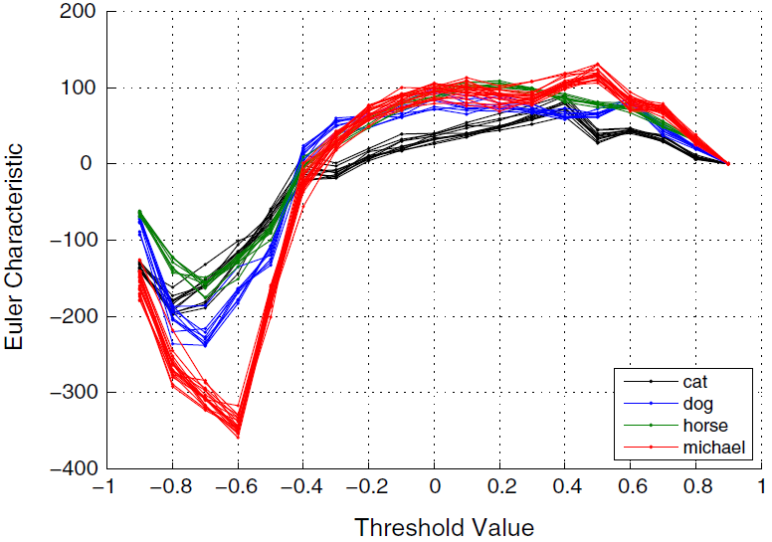
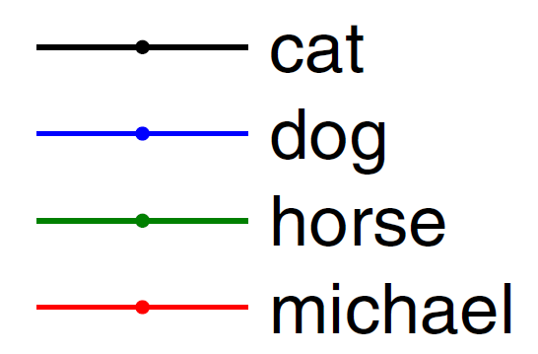
Richardson and Werman used the Euler characteristic graph to classify 3D objects.

Slide 34
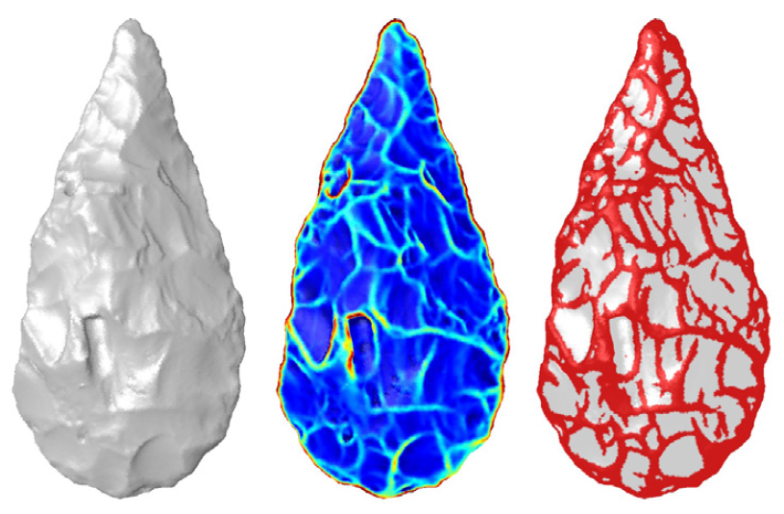
Richardson and Werman used the Euler characteristic graph to classify 3D objects.
The Euler characteristic curve helps distinguish between similar artifacts from two sites.

Slide 35
3
Persistent Homology

Slide 36
Euler characteristic is a simple topological invariant.
Homology is a much more sophisticated topological invariant.
$$H_{n}\left(X\right)={\ker{∂_{n}}}/{\operatorname{im}{∂_{n+1}}}$$
Betti numbers
$β_{0}=$number of components
$β_{1}=$number of holes
$β_{2}=$number of voids
$$⋮$$
Connection:
$$χ=β_{0}−β_{1}+β_{2}−β_{3}+⋯$$

Slide 37
Persistent Homology
Persistent homology is an algebraic method for discerning topological features of data.
e.g. components, holes,
graph structure
e.g. set of discrete points, with a metric

Slide 38
Example: What topological features does the following data exhibit?
Problem: Discrete points have trivial topology.

Slide 39
Idea: Connect nearby points.
1. Choose a distance $d$.
2. Connect pairs of points that are no further apart than $d$.
$$d$$
Problem: A graph captures connectivity, but ignores higher-order features, such as holes.

Slide 40
Idea: Connect nearby points, build a simplicial complex.
1. Choose a distance $d$.
2. Connect pairs of points that are no further apart than $d$.
3. Fill in complete simplices.
$$d$$
4. Homology detects the hole.
Problem: How do we choose distance $d$?

Slide 42
If $d$ is too small…
…then we detect noise.

Slide 44
If $d$ is too large…
…then we get a giant simplex (trivial homology).

Slide 45
Problem: How do we choose distance $d$?
This $d$ looks good.
How do we know this hole is significant and not noise?
$$d$$
Idea: Consider all distances $d$.

Slide 46
Each hole appears at a particular value of $d$ and disappears at another value of $d$.
$$d_{1}$$
We can represent the persistence of this hole as a pair $\left(d_{1},d_{2}\right)$.
We visualize this pair as a bar from $d_{1}$ to $d_{2}$:
$$d_{2}$$
$d$:
$$d_{1}$$
$$d_{2}$$
A collection of bars is a barcode.

Slide 47
Example:
Record the barcode:
$d$:
$$0$$
$$1$$
$$2$$
$$3$$

Slide 48
Example:
Short bars represent noise.
Long bars represent features.
Record the barcode:
$d$:
$$0$$
$$1$$
$$2$$
$$3$$

Slide 49
Questions?
?

Slide 50
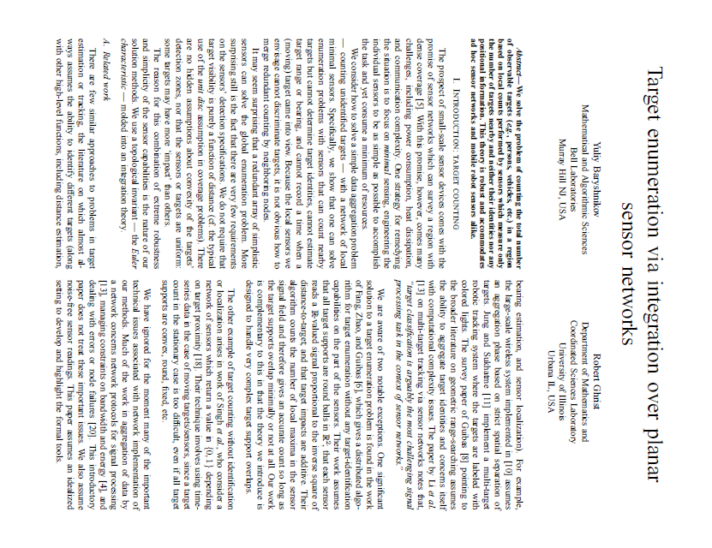
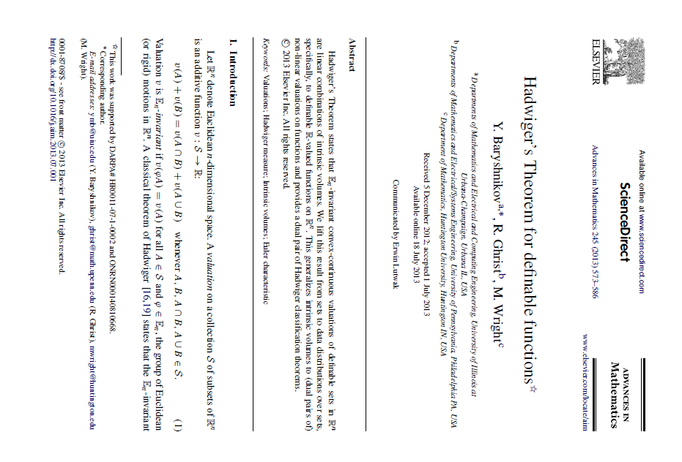
For more information:
Yuliy Baryshnikov and Robert Ghrist. “Target Enumeration via Euler Characteristic Integration.” SIAM Journal on Applied Mathematics, vol. 70, no. 3 (2009), p. 825 – 844.
Yuliy Baryshnikov, Robert Ghrist, and Matthew Wright. “Hadwiger’s Theorem for Definable Functions.” Advances in Mathematics. vol. 245 (2013), p. 573 – 586.
Eitan Richardson and Michael Werman. “Efficient Classification Using the Euler Characteristic.” Pattern Recognition Letters. vol. vol. 49 (2014), p. 99 – 106.
Robert Ghrist. “Barcodes: The Persistent Topology of Data.” Bulletin of the American Mathematical Society. Vol. 45, no. 1, 2008, p. 61 – 75.

