Slide 1

Grace Cain
Class of 2020
Psychology Major, Child and Family Studies Minor
Praxis/Work Experience: Camp Baker
(Judge Baker Children’s Center)

Slide 2
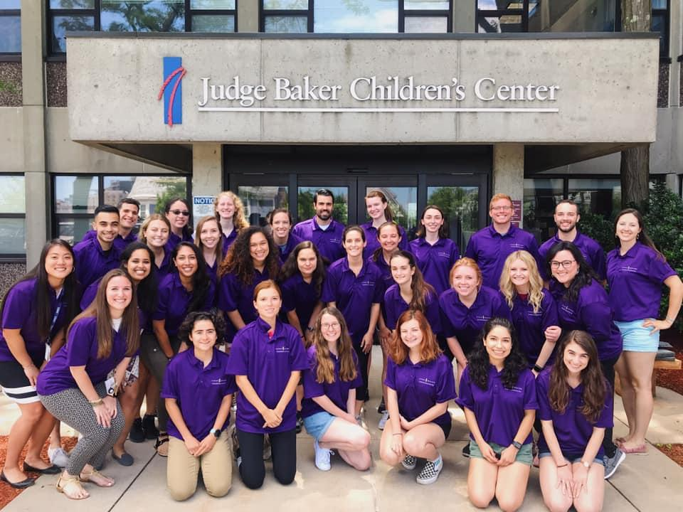
Camp Baker
Camp Baker is an STP (Summer Treatment Program) for children with ADHD based out of Judge Baker Children’s Center in Boston. The program uses a point system, individualized rewards and a timeout protocol to help children regulate their emotions and behavior.

Slide 3
Point System, Timeout Protocol & Active Ignoring
Point System: campers earn points for positive behavior (point store, Fun Friday) & lose points for negative behavior.
Timeout Protocol: 5 min of calm sitting out of activities when campers
  do not follow a command after a second time
  are destructive/violent.
Active Ignoring: negative behavior is ignored outside of point calling (unless dangerous → nonviolent crisis intervention→ timeout room)

Slide 4
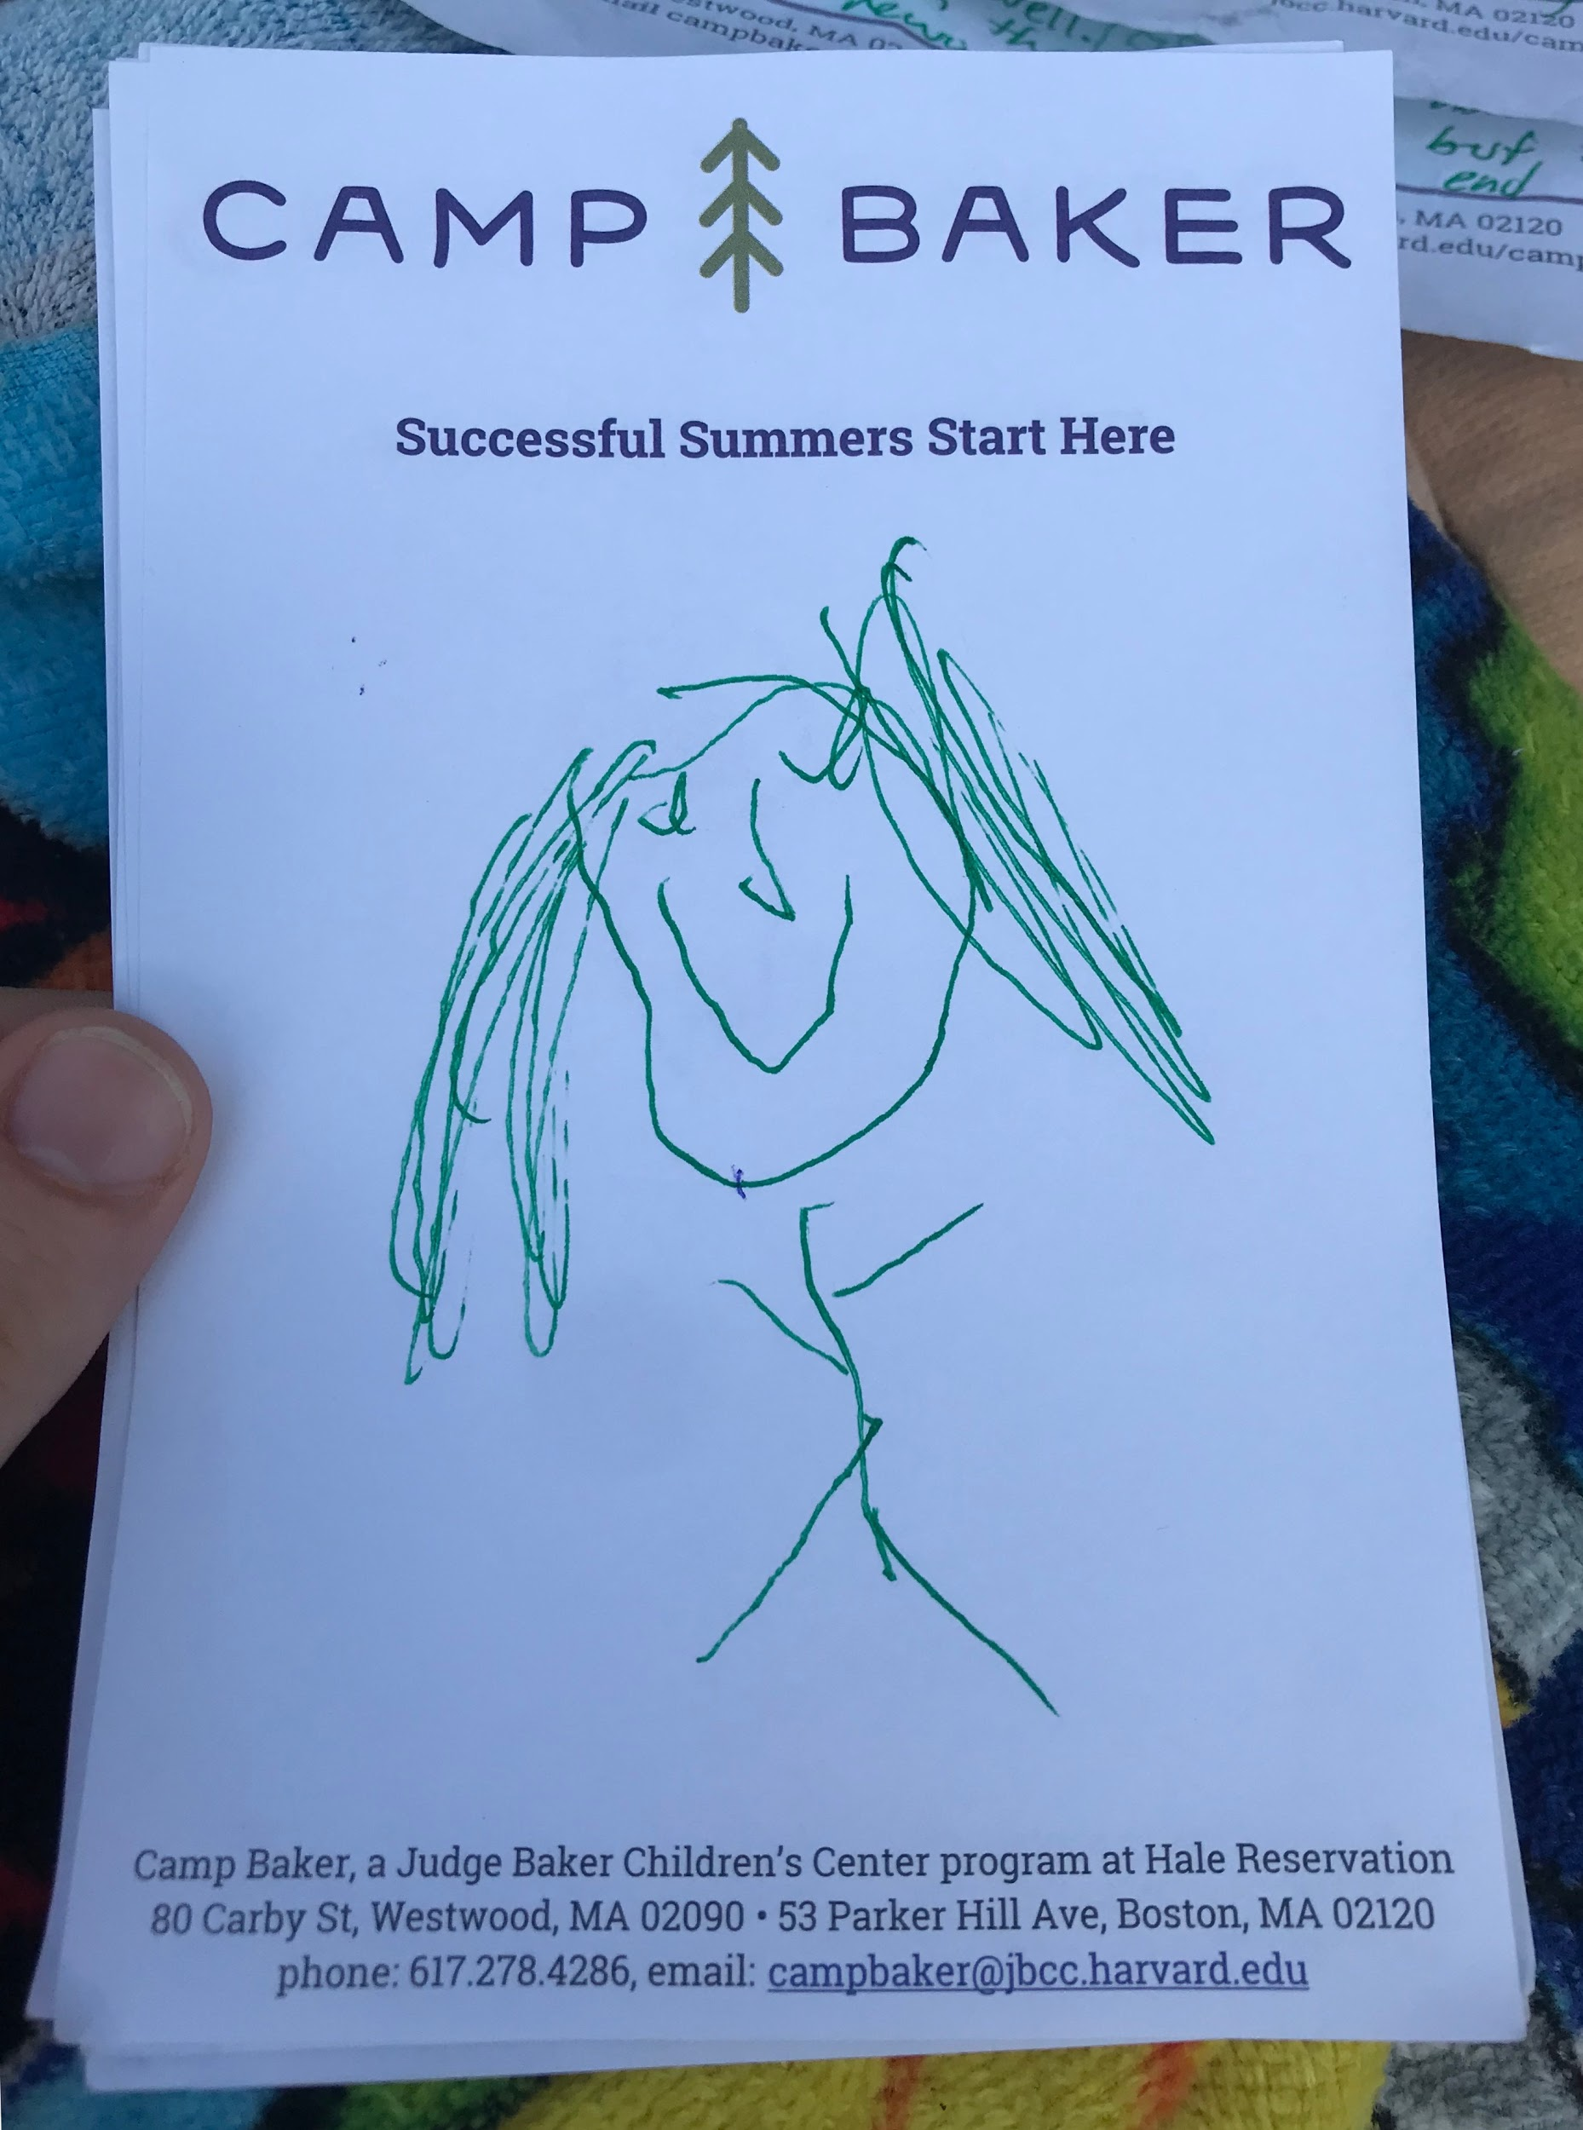
Pride Skills
Praise (make sure praise is labeled i.e. “I like how you are coloring quietly”)
Reflect (shows you are listening, reinforces speech)
Imitate (positive reinforcement, cooperation)
Describe (communicates interest)
Enthusiasm
*ignore inappropriate behavior
Drawing of me by camper, age 7.

Slide 5
My Experience
Training:
Learned treatment program (i.e. memorize the point system, learn timeout protocol, complete crisis intervention training)
Camper Simulations
Responsibilities:
Managed a group of 13 6 & 7-year-old boys with 5 other counselors
Recorded points, input data & made physical management reports
Prepared age appropriate soccer drills & lead games
Debriefed parents at the end of the day with campers’ daily “report cards”
Notes:
Poor motor coordination

Slide 6
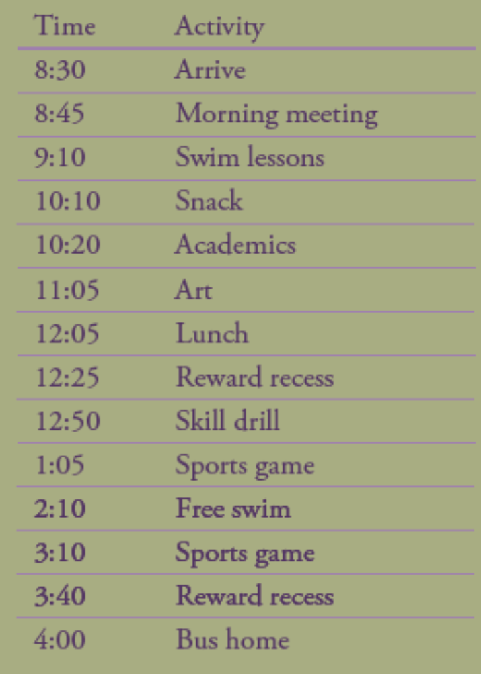
Daily Schedule
*counselors arrive at 7:30 to prepare for day
& get campers on bus
Parent Night held once a week
During parent night: counselors & campers watch a movie, play games and eat pizza (until 6 pm).

Slide 7
Overview
My first experience implementing treatment
Challenged my assumptions about the treatment
Broadened the clinical populations I want to work with in future
Helpful connection for after graduation job search

Slide 8
https://campbaker.org/summer-2020-positions/
Positions for this summer as Undergraduate Counselors or Teaching Assistants are open for this summer, camp tentatively starting July 8th.

