Slide 1
CFS Senior Praxis Presentation
Rylee Fennell

Slide 2
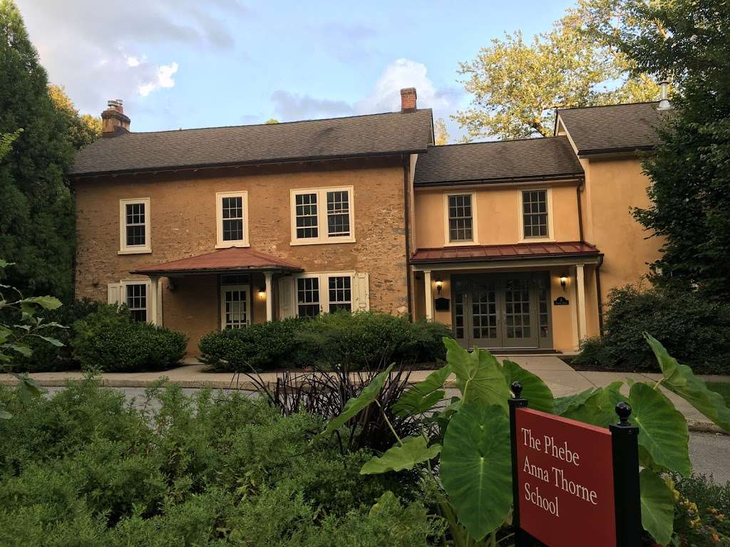
Phebe Anna Thorne Kindergarten
4 years as a student aide
Responsibilities:
  Facilitate daily activities
  Support students with special needs
  Assist in learning centers
  Encourage social growth
Best part of undergrad!

Slide 3
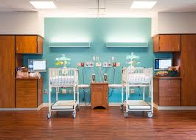
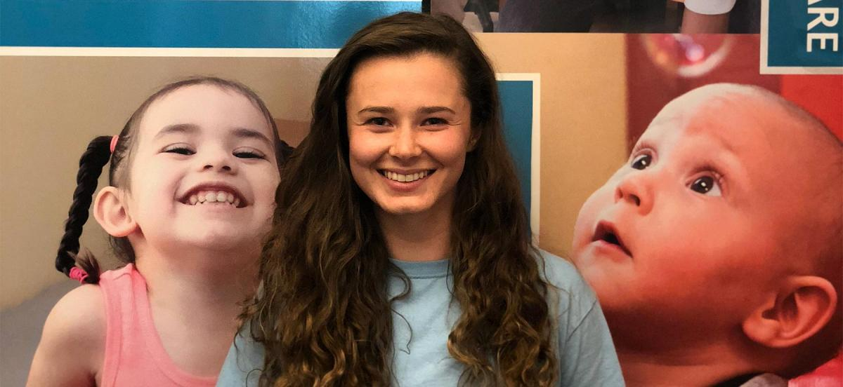
Weisman Children’s
Gertrude Albert Heller Memorial Grant Recipient
Facilities: pediatric inpatient rehabilitation hospital, medical daycare, outpatient facility
Responsibilities:
  Engage with patients and their families
  Assist and observe SLPs and child life therapists
  Develop therapy materials
  Administrative work
Notes:
Hospital -- pic is of the pulmonary unit -- mainly for long term intensive care -- have dieticians, slps, pts, ots, child life, neuro, respiratory, etc. -- all kinds of specialties on call -- there I mainly provided social support to patients, assisted slps and child life therapists
Medical day -- spent most of my time here in the toddler program -- the facility had 4 designated rooms -- sensory for kids who need 1-on-1 intensive care and have limited mobility, infant, toddler, and school age -- here I worked alongside nurses throughout the day to help the kids have fun while being safe and administering individualized care
Outpatient -- shadowed slps a lot, developed therapy materials/ built a “summer camp” room for the week that had different activities/sensory features, administrative work -- important to see how much documentation is behind each patient

Slide 4
Thanks!

