Slide 1
CFS Senior praxis Poster
Andrea Moreno

Slide 2
1.
Overbrook educational center

Slide 3
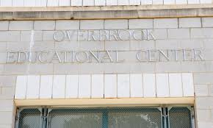
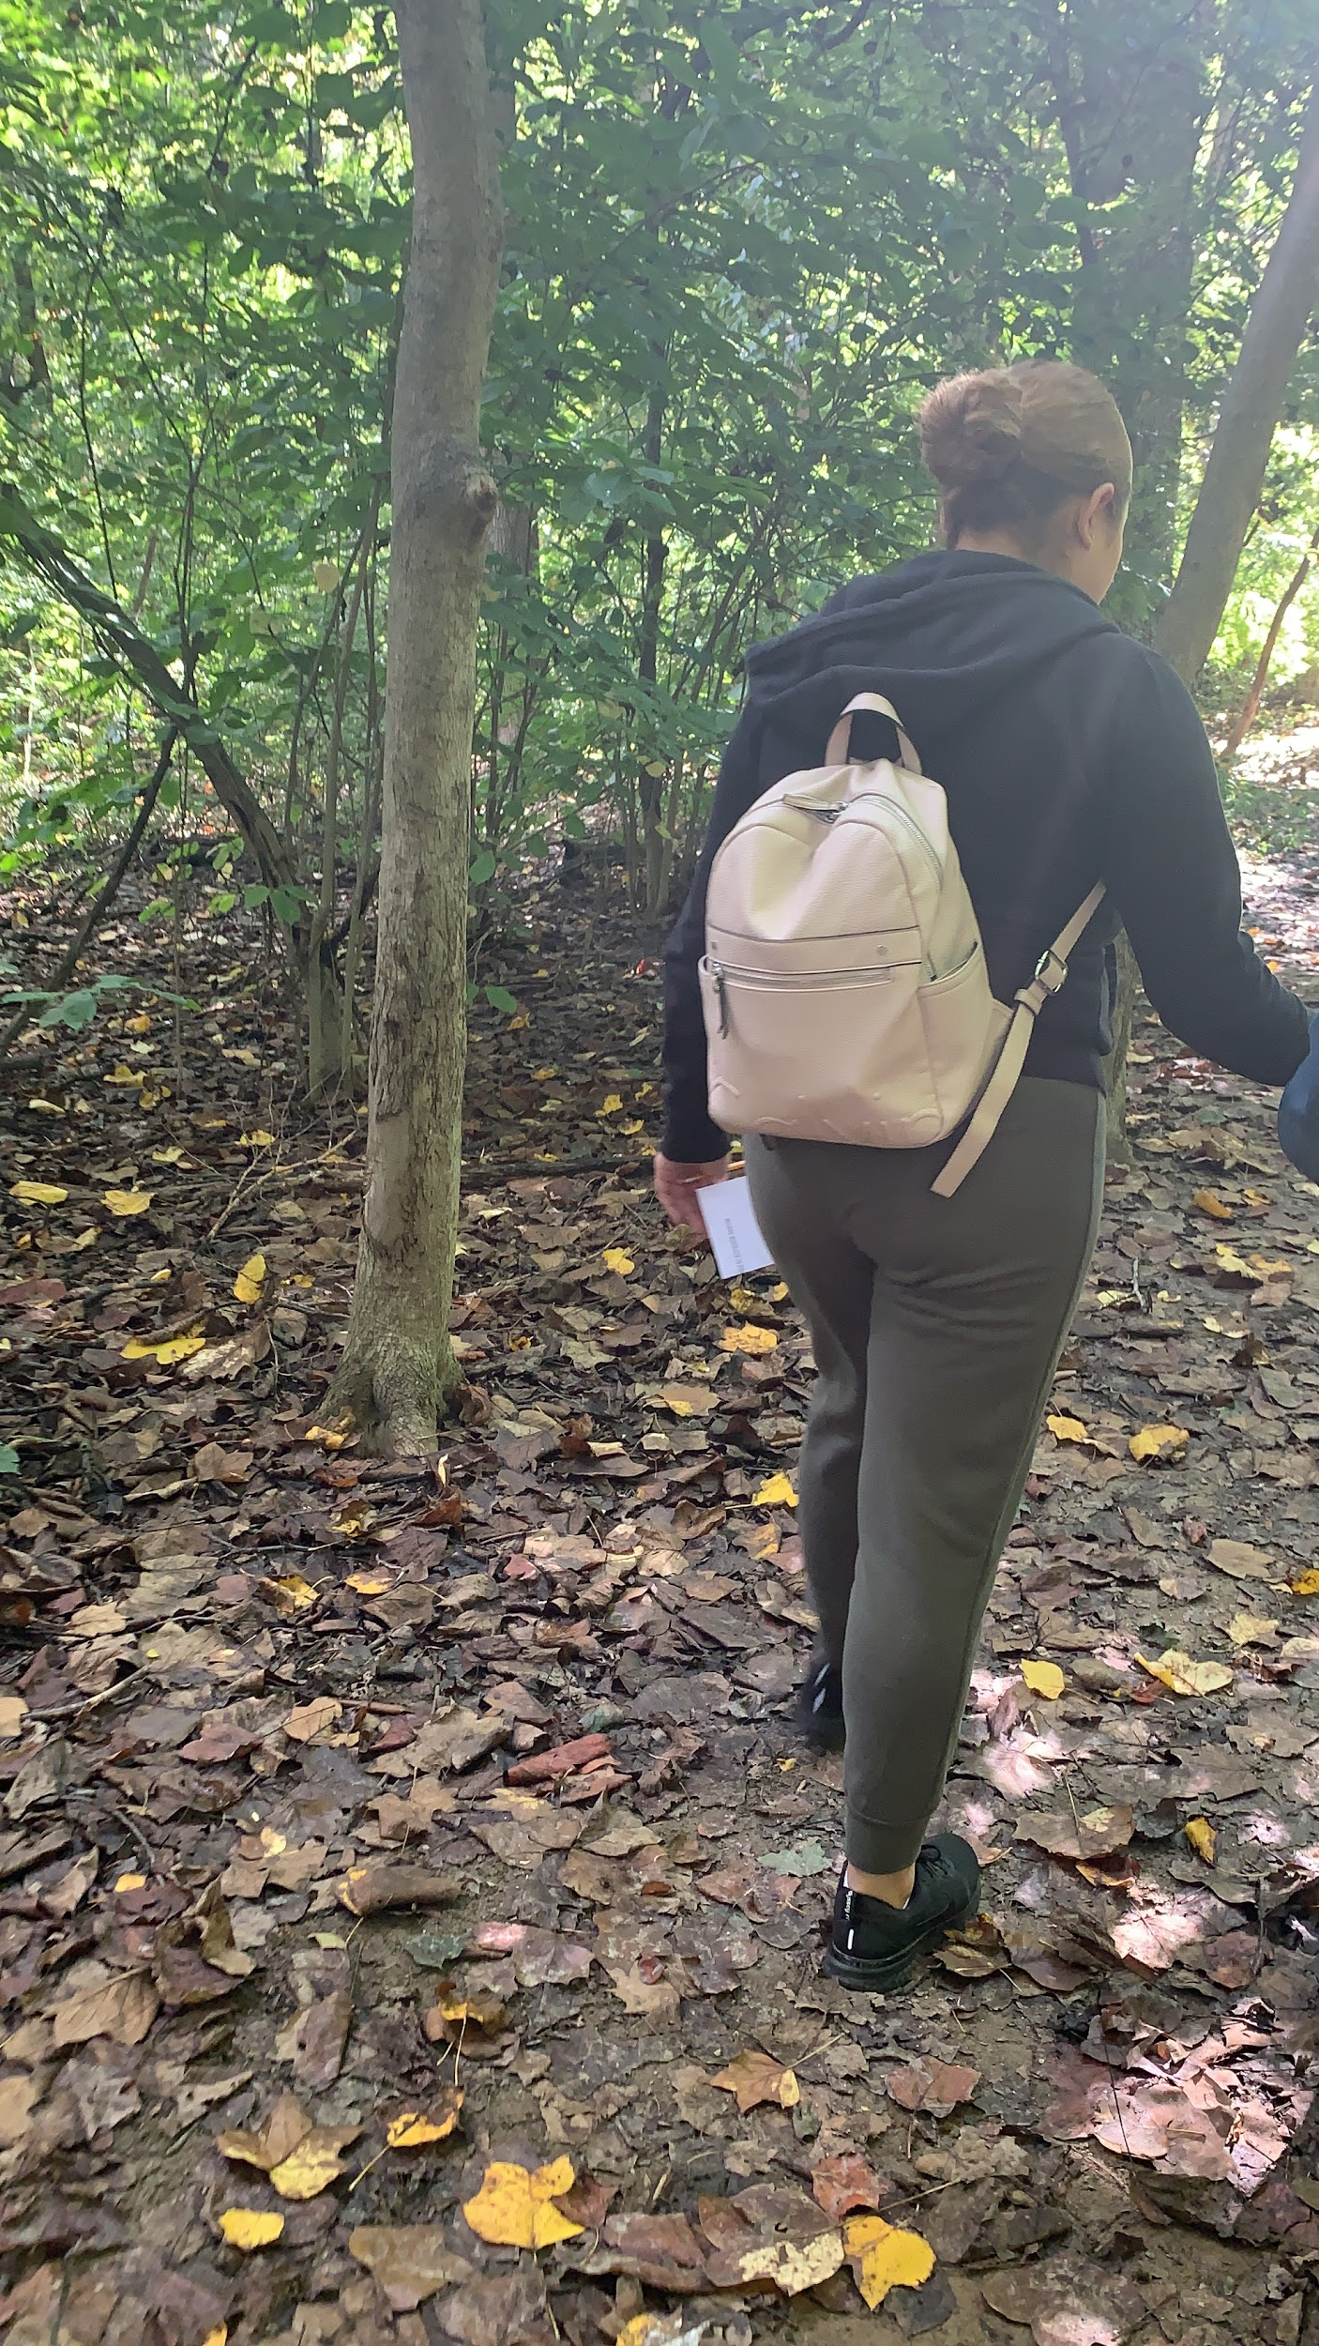
praxis: Perspectives on Special education
Fall Semester ‘19
Once a week for ~3 hours
4th & 5th graders
Science + Math
What did I do?
Observed (took notes)
Assisted the head teacher with the students
Impact:
Working closely with students diagnosed with visual impairments taught me to think outside the box and consider closely the different needs of each student

Slide 4
2.
Big sisters program
~ 2 years

Slide 5
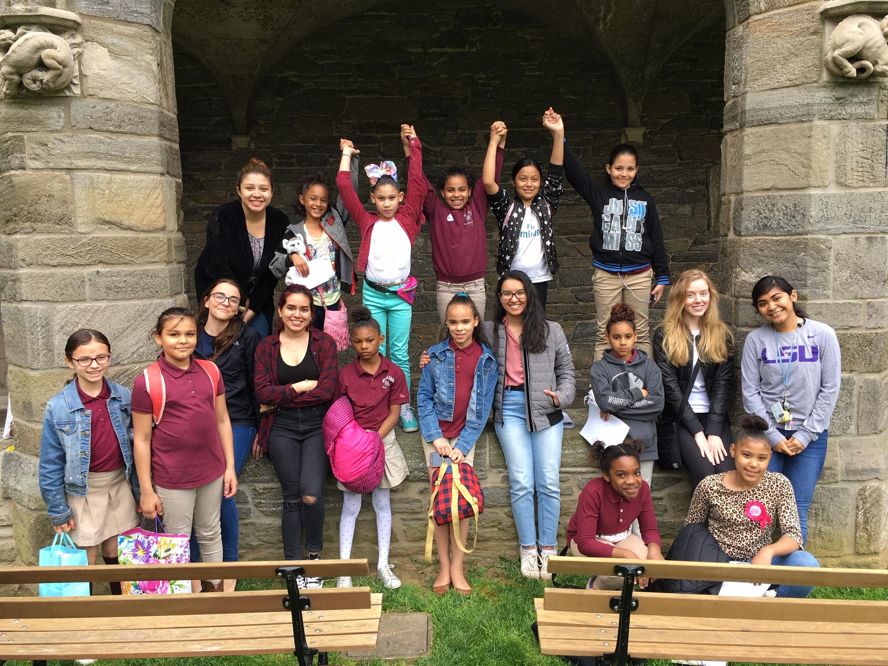
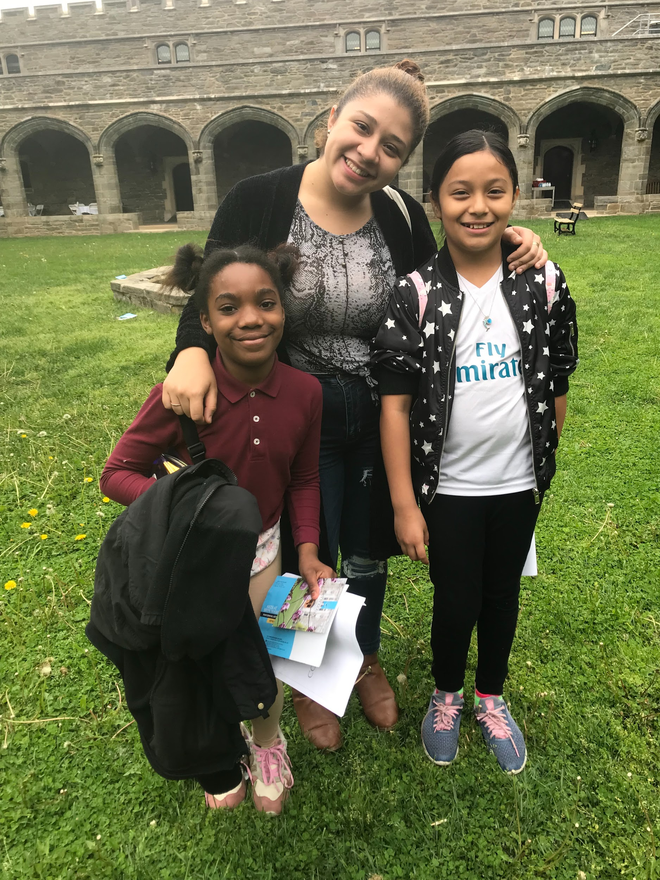
Volunteering: Willard Elementary School (Kensington, PA)
Once a week ~ 1 hour
3rd & 4th grade girls needing that one-on-one help
What did I do?
WEEKLY LAYOUT: Icebreaker, Reading + Writing, Fun activities (i.e., board games)
Impact:
Paved my post grad plans towards education, specifically working in low income communities
Taught me to have patience and be flexible with my little sisters

Slide 6
Overall
The opportunities I have had with working with children while I have been at Bryn Mawr have shaped my decision to continue working with children post-graduation. The experiences I have gained have provided me with a stepping stone towards my career choice in education and as of now towards becoming a teacher. I have learned what it is like to be an adult figure in a classroom and what planning lessons can look like. I knew I wanted to work with children before coming to Bryn Mawr, but these experiences have better prepared me on how to shape little minds in classrooms :)

Slide 7
WHat is next for me?
Match charter schools in boston
Teaching license
M.e.t Degree

Slide 8
Thank you!
Questions/ Comments?

